Slide 1
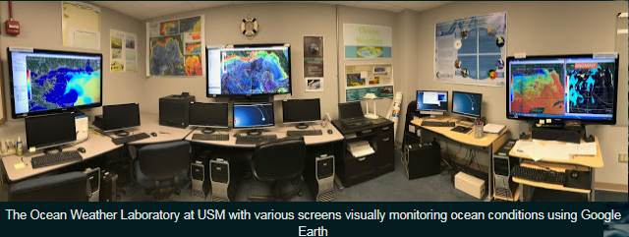
Ocean Weather Laboratory – Monitoring - Real time Biological - optical and Physical Properties in the Gulf of Mexico Ocean models (HYCOM-NCOM) and Satellite (VIIRS) Events and Anomalies
Robert Arnone , Brooke Jones ,
University of Southern Miss
Dynamic
Anomaly
Properties
DAP
Data Access and online

Slide 2
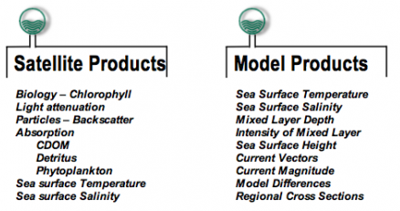
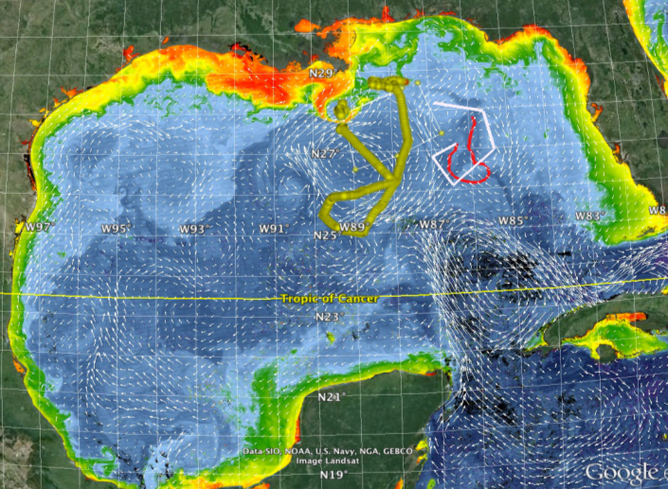
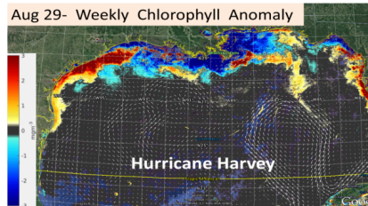
Ocean Weather Laboratory
http://www.usm.edu/marine/research-owx
Daily Nowcast 2013- Present
Higher
resolution
HYCOM
NCOM (4, 1 km)
VIIRS - Color / SST
3 km
750m
Chlorophyll
Light Attenuation
Particle Backscatter 551
Euphotic Depth
Absorption 443
Sea Surface Temperature
Sea Surface Salinity
“Hotspots”
Abnormal Environmental Conditions
Dynamic Anomaly Properties
2013 – Present NOAAERDA-Link
Dynamic
Anomaly
Properties
Satellite Products - SIX:
1) Chlorophyll - chl 2) SST - mcsst
3) Euphotic Depth – ZEU 4) Absorption 443 a443
5) Backscattering (particles) 6) Salinity -
Difference
DAP
Week
8 week Mean
2 weeks
Difference with Weekly and MEAN → Anomaly
Circulation Model Four –America Seas Model
1) Sea Surface Temperature - 2) Surface Salinity –
3) Surface Current magnitude 4) direction
Identifying locations of Ocean Events

Slide 3
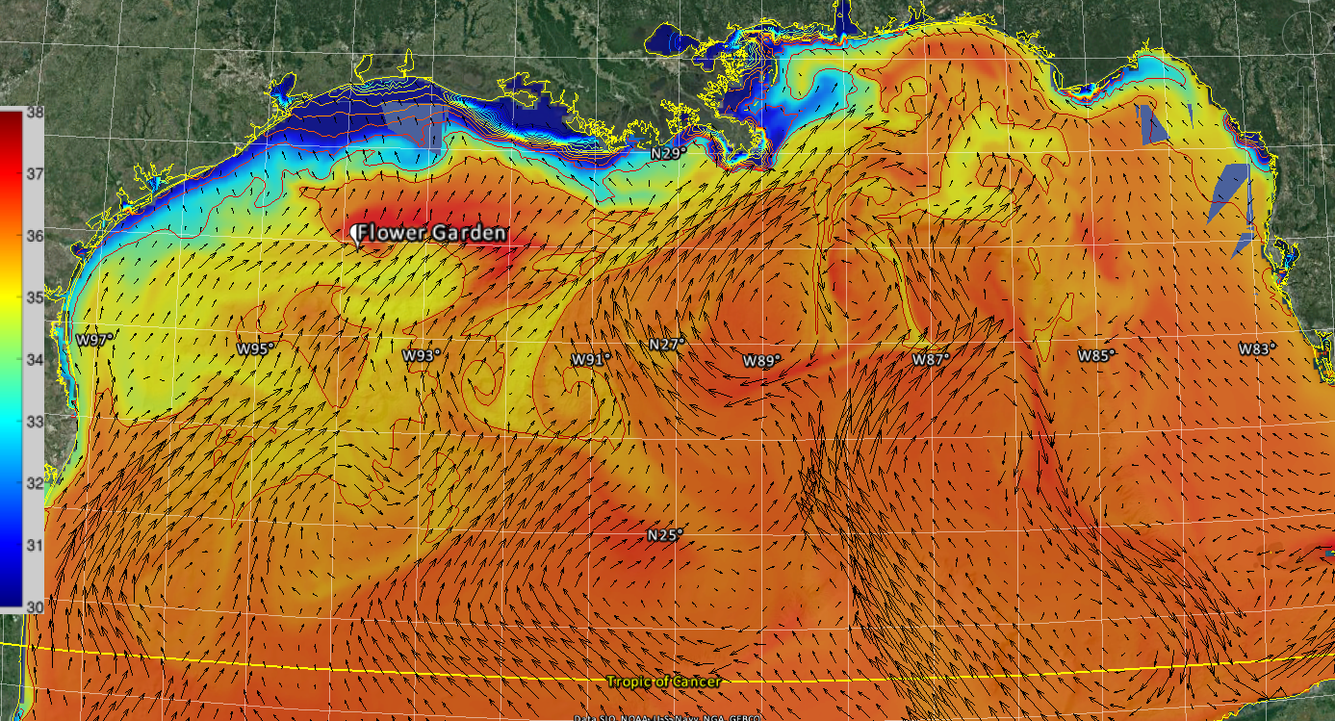
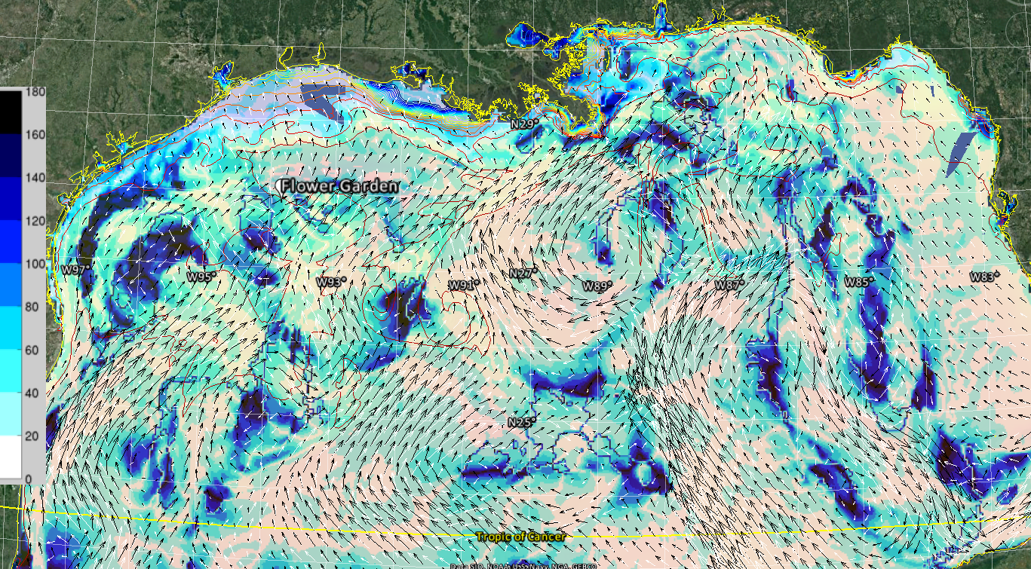
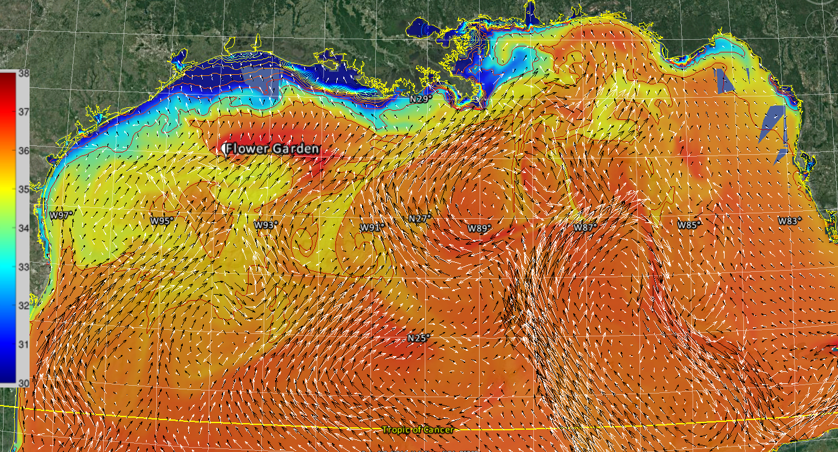
Daily OWX Products
Identify Locations of
Uncertainty
Model Difference Mar 28, 2018 NCOM and HYCOM
Surface salinity and currents
Uncertainty Currents Difference
NCOM Current White
HYCOM Black
HYCOM
Opposite
Direction Difference
Uncertainty is the Difference
Add Data available for GOOGLE EARTH
NCOM

Slide 4
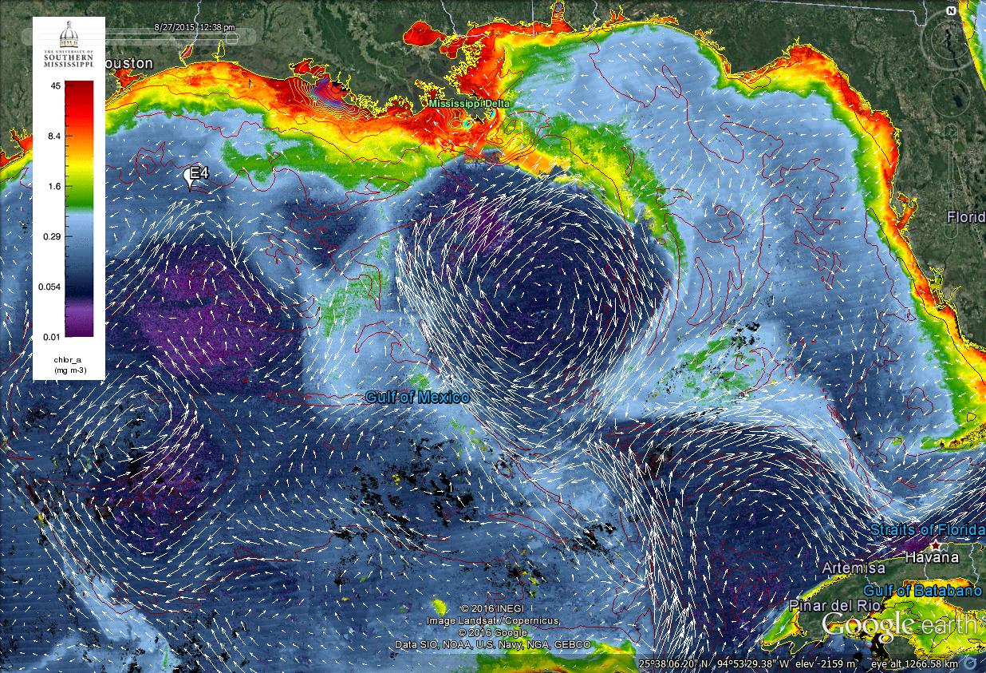
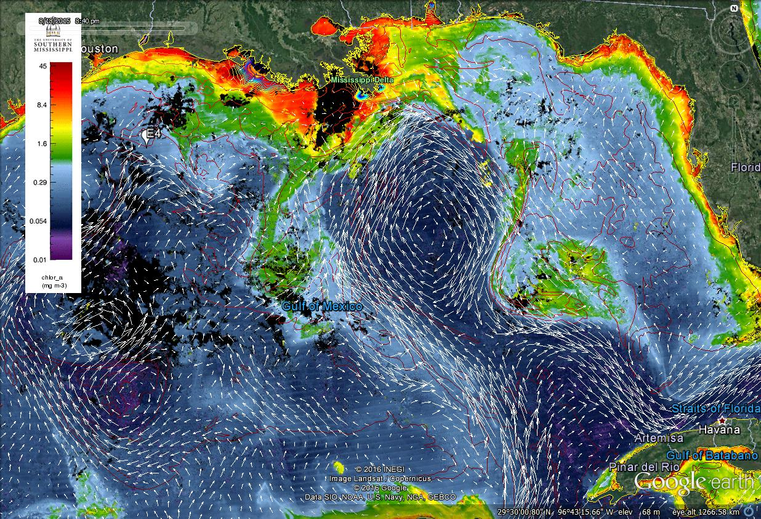
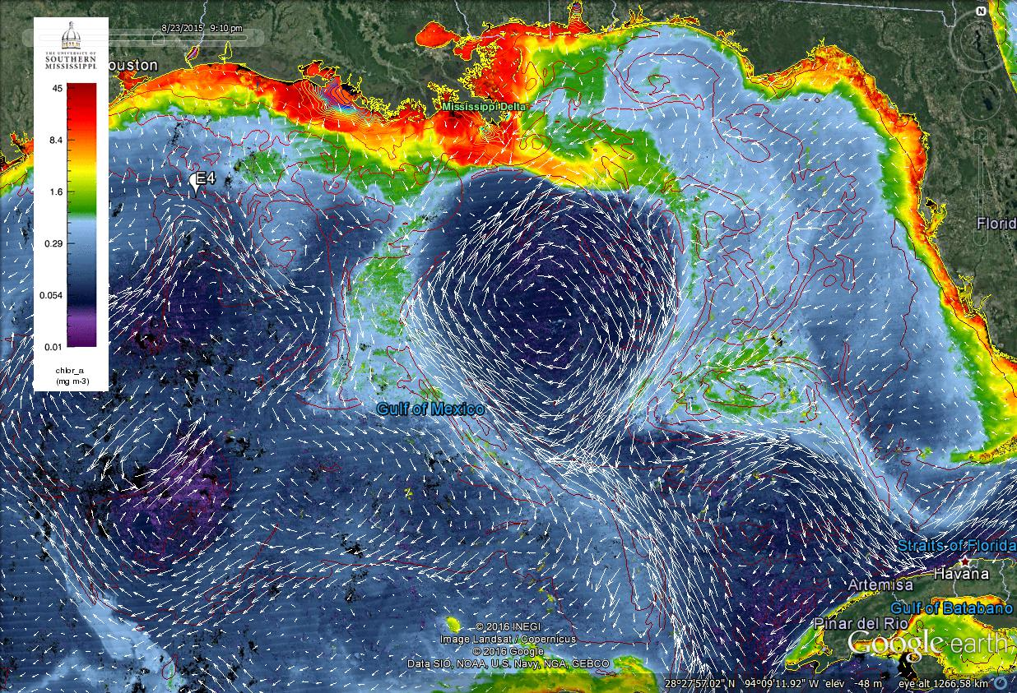
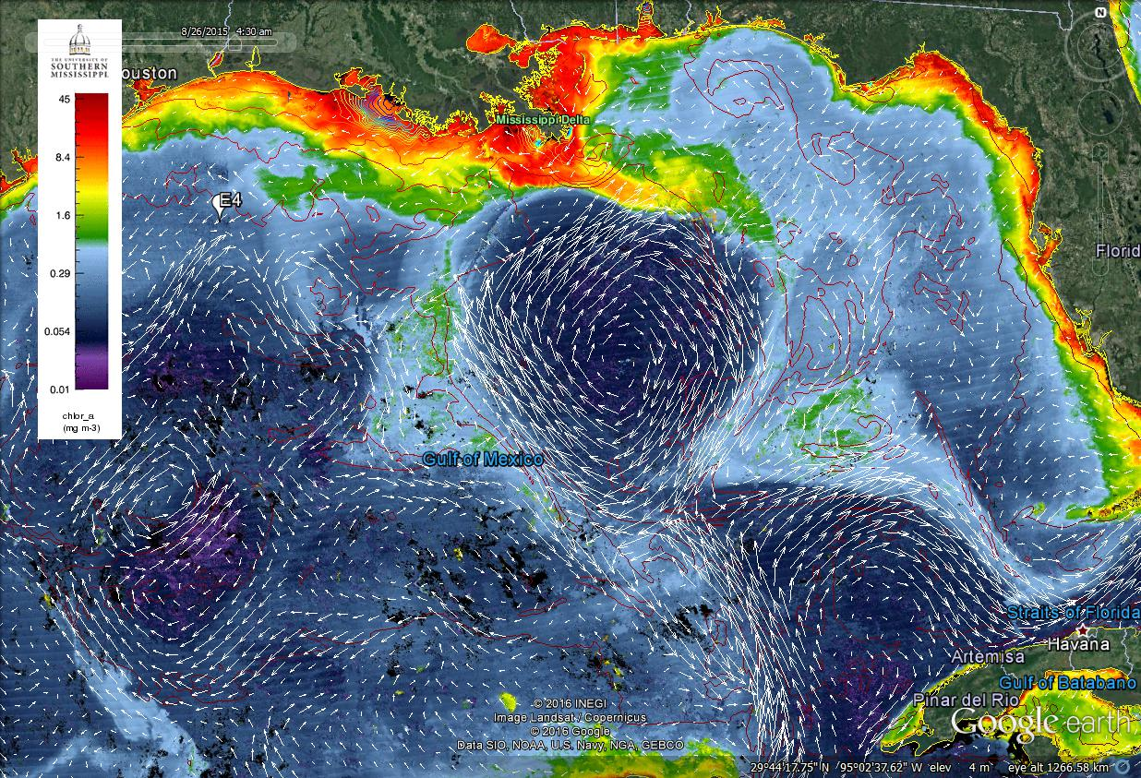
Event - Mississippi Plume to Key West Aug 2015
LOOP Current
Plume to Key West
How Abnormal was this advent in last few months?
What regions were affected? Define Level of Uncertainty?
Aug 27,2015
Aug 24,2015
Aug 19,2015
Aug 26,2015
Cyclonic
Eddy
Daily Chlorophyll and Surface Currents and Salinity Contours?

Slide 5
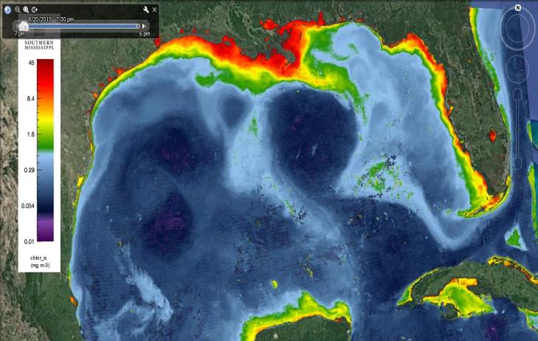
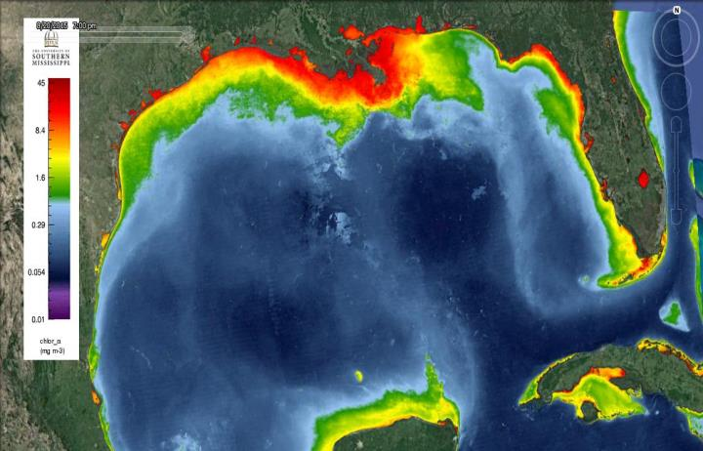
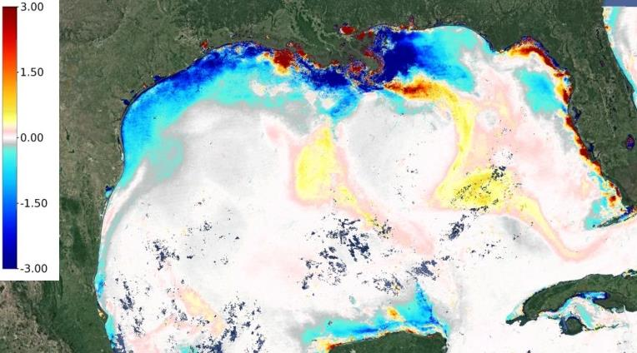
Defining Dynamic Anomalies Properties –DAP
Dynamic
Anomaly
Properties
DAP
Where are the abnormal Hotspots in 8-21- 2015
Chlorophyll Hotspots
Plume to Key West
mg/m^3
8-21-2015 Weekly Chl
2 week lag 8 Week mean
Higher
None
Lower
Chlorophyll
Anomaly
Lower
2 weeks
8 week Mean
Mg/m²
8-21
8-04 6-04
Higher
Difference with Weekly and MEAN → Anomaly
Tried Different Mean Time Levels
If the Mean to large than no anomaly.
Similar products Used In HABS for data collection
Chl, Eu, bb, Salinity, SST, Currents
Products Anomaly ---- Ai_{n}= i_{n}-Mi_{n}

Slide 6
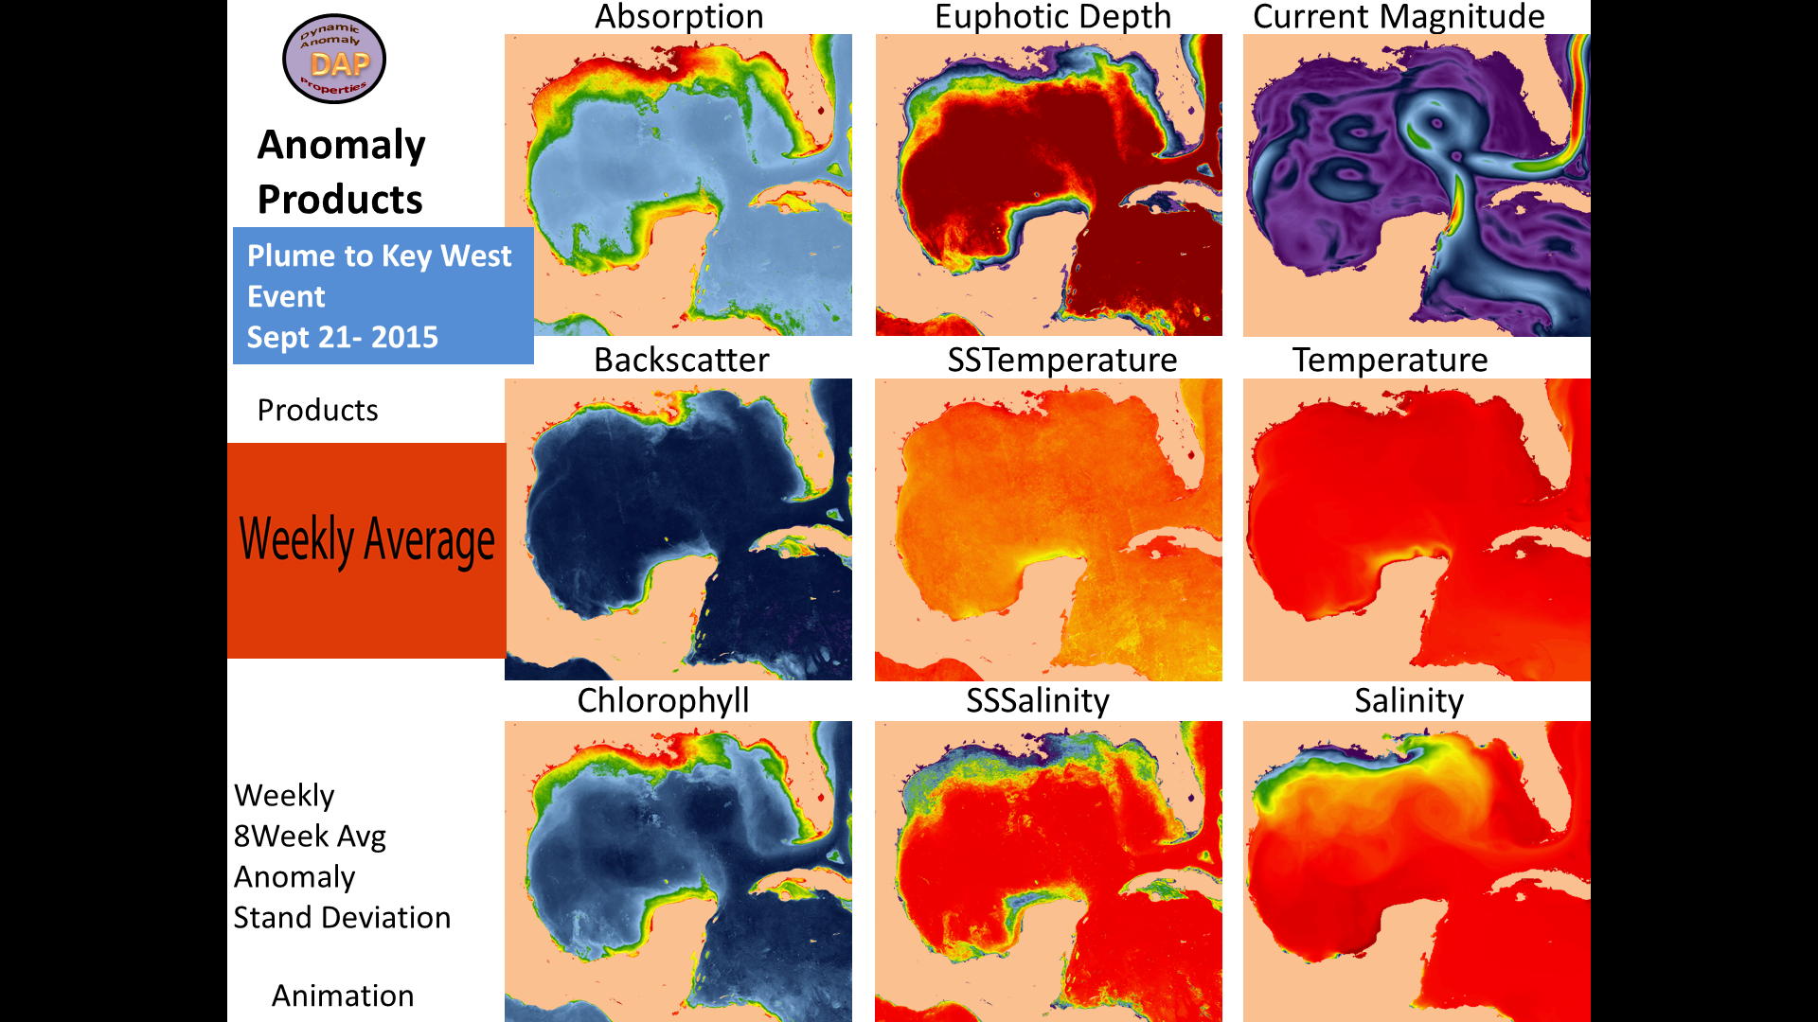
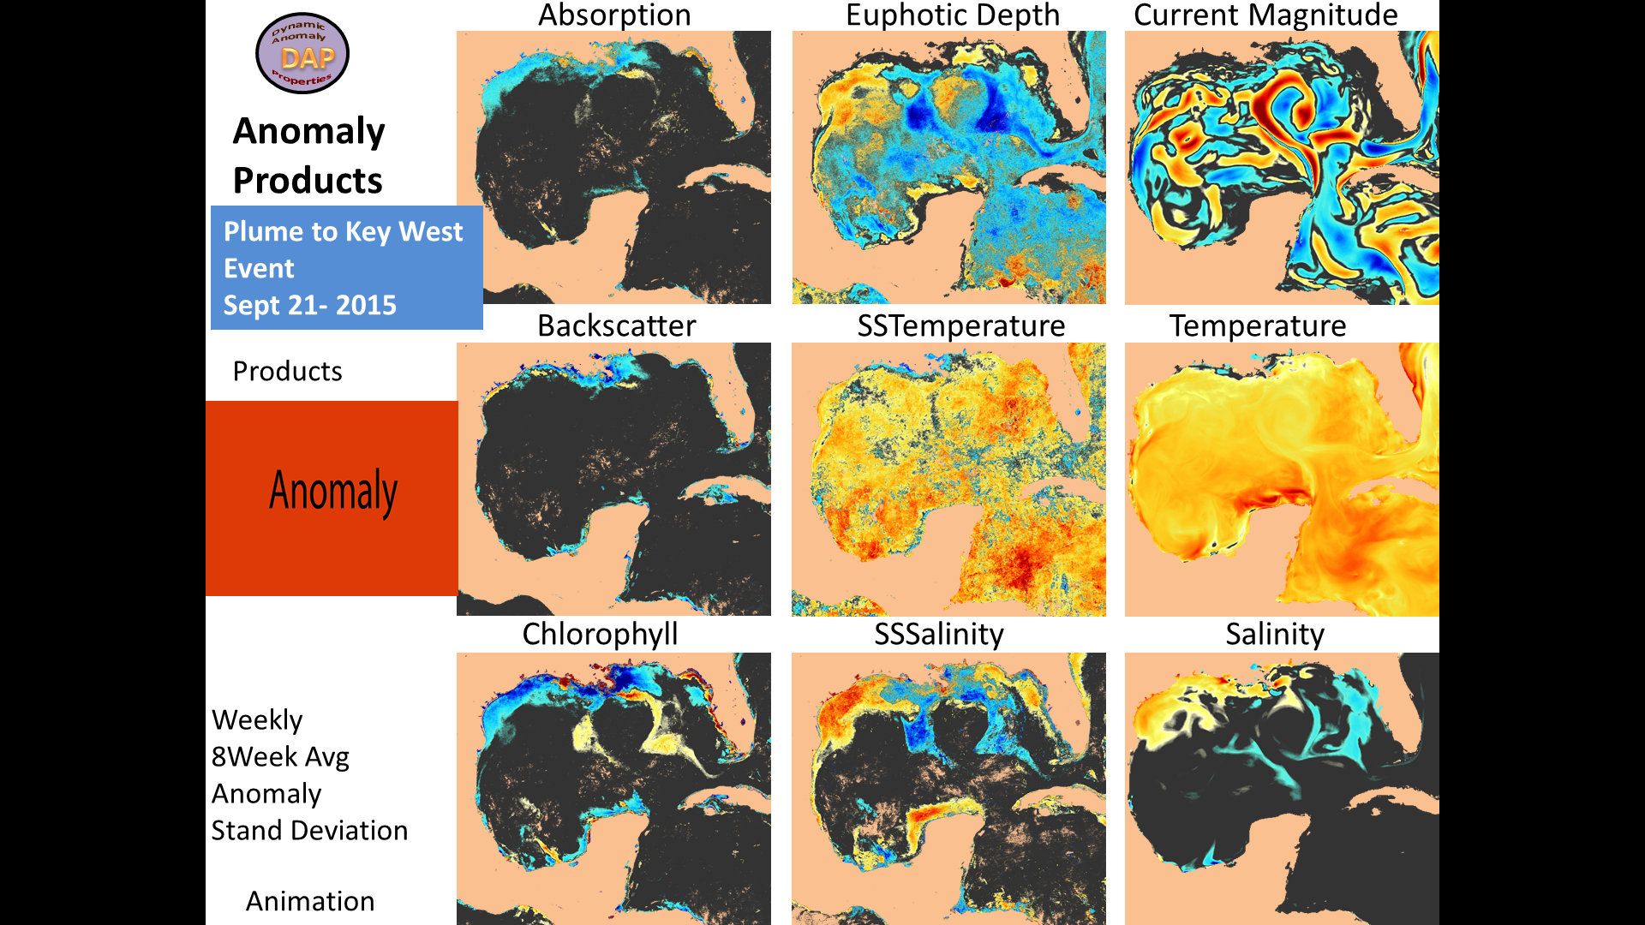
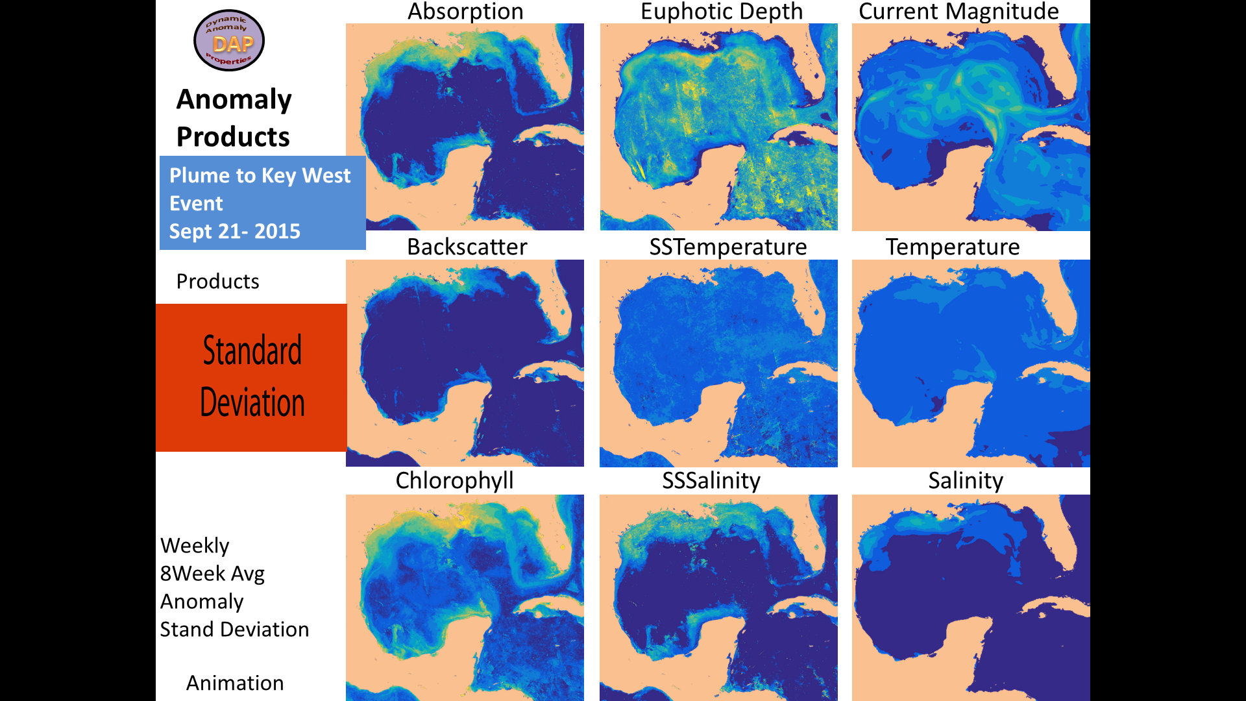
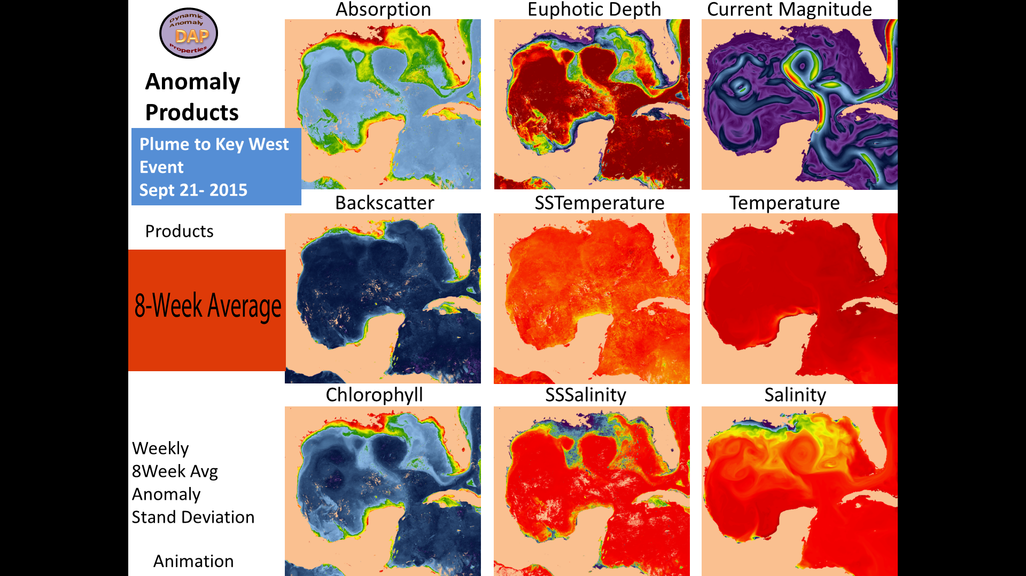
8 Week Average
Weekly
Sept 21, 2015
Sequence
mg/m^3

Slide 7
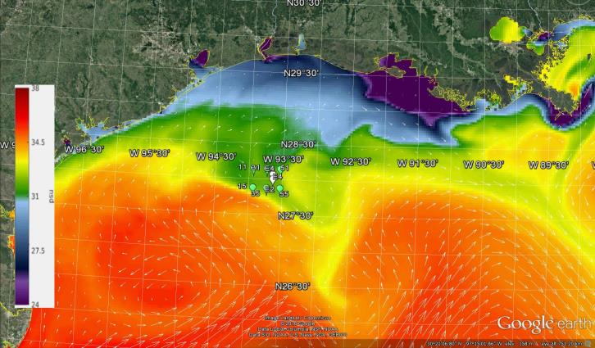
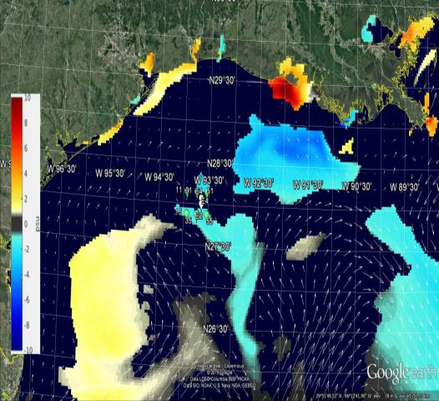
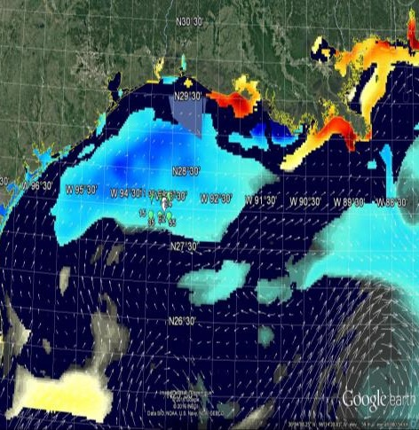
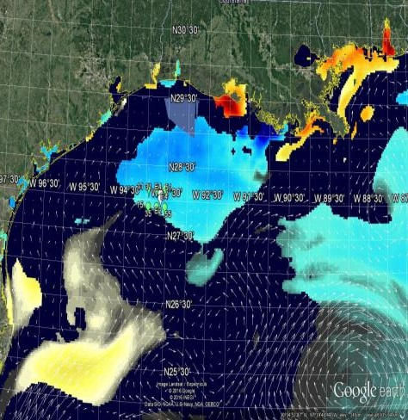
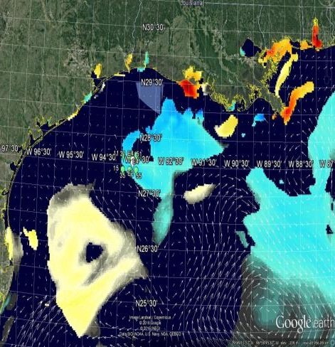
Flower Garden Banks July 2016
Dynamic
Anomaly
Properties
DAP
Bleaching event was observed in late July
Salinity Anomaly - MASK 2
July 27, 2016
Weekly
10
8
6
4
2
0
-2
-4
-6
-8
-10
July 27-2016
Anomaly
2 psu low
psu
Is this Salinity typical ?
Weekly Changes in Salinity Anomaly
July 3- 2016
July 11- 2016
July 19 -2016
What level of Abnormal salinity?
Greater that 2 Standard Deviations
is 2 psu Lower
The Abnormal conditions during this event are
currently under investigation.
What were conditions “prior” to the time it was
observed?
Perhaps the bleaching event was occurring before it was discovered?
Event Started
Low Salinity
Event
Large regional of Abnormal Low Salinity

Slide 8
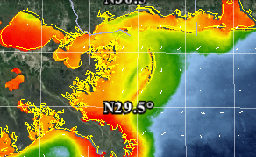
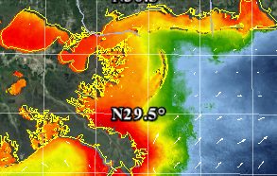
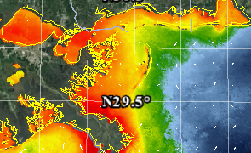
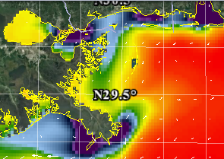
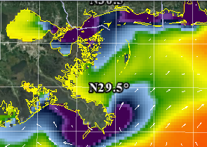
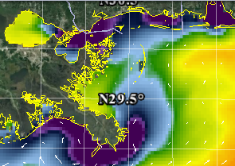
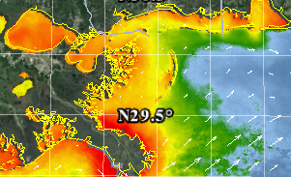
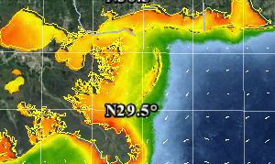
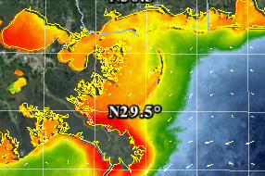
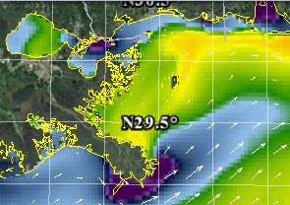
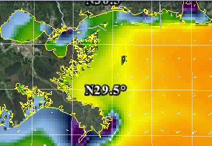
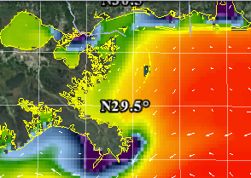
Seasonal Cycle – Backscattering + Surface Salinity
Are they correlated?
AmSeas Model
2015
Backscattering
Mar
Apr
May
Jun
0.5
0.13
0.032
0.008
0.002
0.0005
Jan
Feb
bb551
.5 .11 .22 .05 0
Seasonal
2015
Are Cycles Similar between Bio-physical Properties
Salinity
Backscattering
Jul
Aug
Sep
Oct
Nov
Dec
Plume
Are salinity and backscattering / Chlorophyll seasonal cycles correlated?
Salinity
Plume
38 34 31 27 24

Slide 9
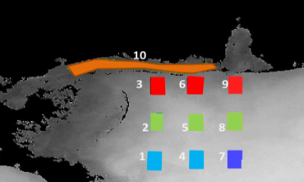
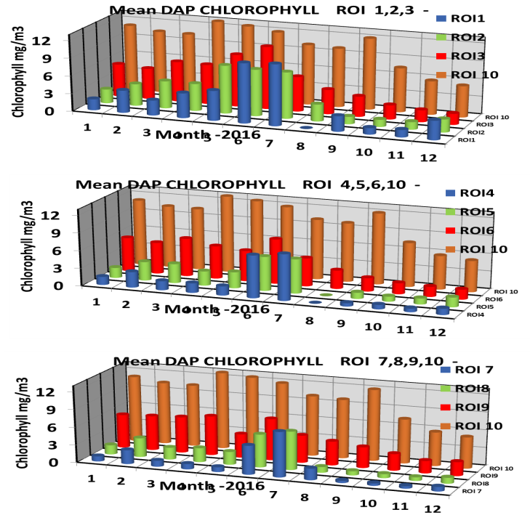
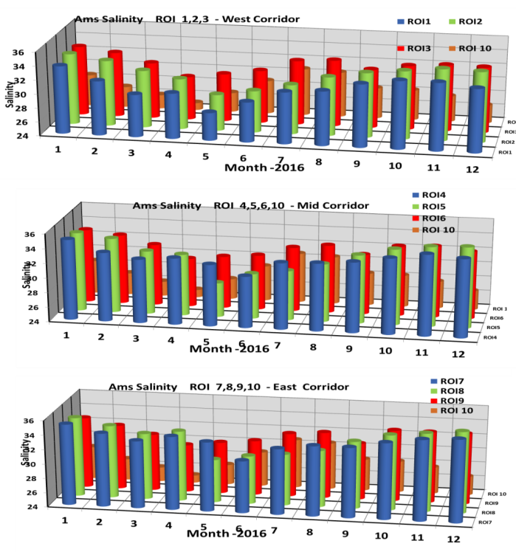
2016 Seasonal Cycle
Mississippi
Different Locations have different Cycles
Monthly offset between the Salinity Plume and Chl
Take time for chlorophyll to respond ?
W M E
Chlorophyll
West
Salinity
1
Plume
Mid
Monthly Seasonal Correlation Scatter Plots
How are Bio-physical properties linearly related in the monthly cycle.
Forecast of how properties are related !
How Chlorophyll responds to Salinity etc.
How does this seasonal Increase Compare
with Salinity MS River Plume
4
East
7
Arnone, R. Jones, B. Ladner, S. "Seasonal trends of biophysical ocean properties and anomalies across the Mississippi Shelf" SPIE 10631, Ocean Sensing and Monitoring 10 (May, 2018) Paper DS 108-19
Jones, B., Arnone, R., "Anomalous Marine Biophysical Conditions due to 2016 and 2017 Wind and Flooding Events in the Northeastern Gulf of Mexico" SPIE 10631, Ocean Sensing and Monitoring 10 (May, 2018) Paper DS108-31
Seasonal Forecast - WHEN will Plume be at location.
Chlorophyll Responding ( 1 month DELAY)

Slide 10
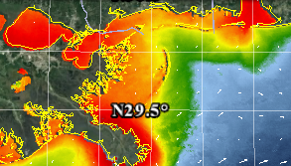
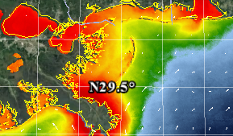
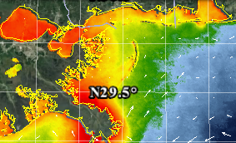
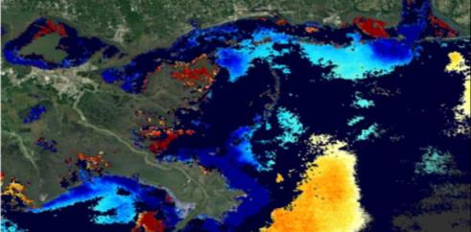
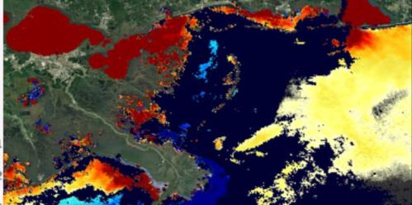
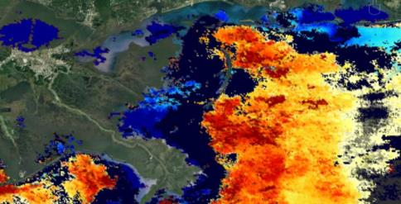
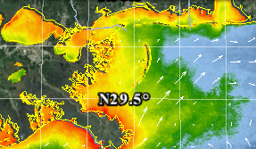
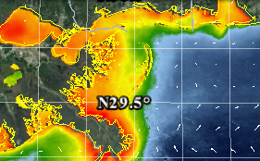
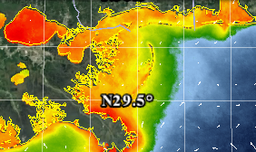
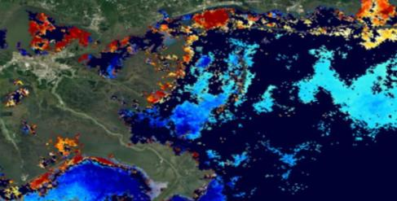
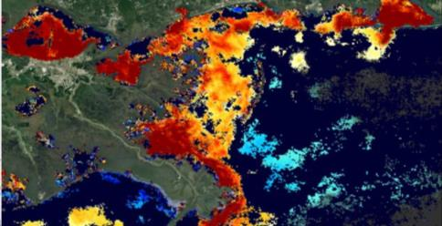
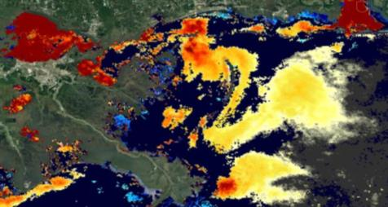
Seasonal 2 month Cycles on MS Shelf
Particles Backscattering → Nowcast and Seasonal Anomaly Cycle
2016
Jan
Feb
Mar
Apr
0.5
0.1
0.022
0.005
0.0005
May
Jun
Higher
Lower
Decrease
Increase
Difference
Week
Anomaly
8 week Mean
2 weeks
Increase
Difference with Weekly and MEAN → Anomaly
Monitored 2017 Hurricanes Ocean events with Abnormal Bio-physical properties.
Anomaly
Jul
Aug
Sep
Oct
Nov
Dec
Changing particle concentration
Seasonal Nowcast and Dynamic Anomaly
Decrease
Arnone, R., Jones, B. " Monitoring abnormal bio-optical and physical properties in the Gulf of Mexico ", Proc. SPIE 10186, Ocean Sensing and Monitoring IX, 101860O (May 22, 2017); doi:10.1117/12.2266789 http://dx.doi.org/10.1117/12.2266789

Slide 11
Bonnet Carrié Spillway opening led to elevated absorption.
FEB 2, 2016
Weekly DYNAMIC Anomaly of Water Absorption 443
Higher
Increase
Increase
Low
VIIRS Absorption Dynamic Anomaly for the weeks of the spillway opening show the increased absorption values in nearby ecologically important waters. As a proxy for the released water mass, the absorption indicates that the river water moved away from the Mississippi Bight (Feb 26, 2016) approximately 4 weeks following the closing of the spillway (Feb 2, 2016).

Slide 12
Bonnie Carrie
March 14- 21, 2018 Chlorophyll
Weekly Average Anomaly
HIGHER
HIGHER

Slide 13
Bonnie Carrie Activity Lake Pontchartrain
ERDAP Online
Chlorophyll l Anomaly 3- 6- 2018 Location of Weekly Seasonal
Hotspot Location
Google
Earth
Chl
Location
Jan Mar Jun Aug Nov Jan Mar
2017 2018

Slide 14
Change if Anomaly in last Three Weeks
March 14- 21, 2018
Bonnie Carrie Activity
High
Changing Lake
Lake improving
Abnormal waters - FLAGGED
March 22-30, 2018
March 30 –April6 2018
High
High
Flagged

Slide 15
Bonnie Carrie
March 14- 21, 2018 Absorption – CDOM Turbidity
Weekly Average Anomaly
HIGHER
HIGHER

Slide 16
Harvey Cruise Track -Houston
Friday Aug 25 8:37PM
Sat Aug 26 12:45 PM
Sun Aug 27 12:45 PM
Mon Aug 28 12:30 PM
Tues Aug 29 12:30 PM
Thurs Aug 31 9:45 AM
Wed Aug 30 12:30 PM
25

Slide 17
Hurricane Harvey -Houston
Chlorophyll Anomaly
Weekly Aug 29
Weekly Sept 6
Low
Anomaly Sept 6
Anomaly Aug 29
Higher
Mask1
Higher
Higher
Low

Slide 18
Hurricane IRMA- Mon Sept 11
Sept 11
Sept 10
Sept 9
Winds
Sept 8

Slide 19
Weekly Am Sea Model Salinity
Sept 6,2017 Sept 6 Sept 14
Anomaly
Anomaly
Anomaly
Anomaly
Sept 22
Sept 30
Hurricane Irma
Is upgrade version of next slide

Slide 20
OWX Data Access
https://www.usm.edu/marine/dap
GOOGLE
EARTH
USM – Website https://www.usm.edu/marine/dap

Slide 21
DATA Access
USM and NOAA NCEI
GOOGLE
EARTH
NCEI- ERDAP for USM _Dynamic Anomaly Data Gulf of Mexico
https://ecowatch.ncddc.noaa.gov/erddap/info/index.html?page=1&itemsPerPage=1000
DAP - OCEAN MODELS
https://ecowatch.ncddc.noaa.gov/erddap/griddap/USM_AMSEAS_DAP.graph
DAP Satellite VIIRS Anomaly
https://ecowatch.ncddc.noaa.gov/erddap/griddap/USM_VIIRS_DAP.graph

Slide 22
Summary
Ocean Weather Lab – for Ecosystem Monitoring
Identify Data Gaps
Dept of Marine Science, Stennis Space Center
Satellite ocean color and SST and Ocean Models data
Daily Nowcast bio- optical and physical products
SNPP VIIRS - Additional new satellites
Ocean Events Dynamic Anomaly Properties (DAP)
Water quality properties .
Products included for Google Earth for users decision makers.
Available data sets – USM and ERDAP- NOAA- NCEI

Slide 23
Dynamic Anomaly Properties (DAP) – Products Description
Ocean Weather Laboratory (OWX) , University of Southern Miss.
Robert.Arnone@usm.edu E.Brooke.Jones@usm.edu
Biological, Optical, and Physical Ocean anomaly properties for the Gulf of Mexico are weekly products created by the OWX to identify areas of abnormal events using (VIIRS) satellite and America Seas NCOM ocean model (Arnone, Jones: 2017). Anomaly properties include the difference of the weekly average and the previous 8 week mean with a 2 week lag.
Positive anomaly indicates an increase and negative values a decrease.
11 Biological, Optical, and Physical properties with 9 products for each.
Products - 6 Masks (.5 - 4) of the Standard deviation of the 8 Week mean to identify the level of the anomaly.
The Mask can be overlaid on the anomaly to block areas less that std Deviation Mask.
FORMAT data Files are both NCDF and kml format for use in GOOGLE earth.
A - Properties
Bio- optical physical name
VIIRS
1. Chlorophyll→ CHL
2. Zeu- Photic depth ZEU
3. Sea Surf Temperature MCSST
4. Kd- Attenuation Coef KD486
5. BB551- Backscattering BB551
6. Absorption 443 A443
7. Salinity (absorption 486-550) SAL
America Seas Model
8. Sea Surf Temperature amsst
9. AmSalinity amsal
10. AmCurrents amcurr
11. Am AbCurrent Vector amC1
B - Products –KML
For each property
File Name
1. Weekly
2. StDev Mask 4
3. StDev Mask 3
4. StDev Mask 2
5. StDevmask1
6. StDevMask1.5
7. StDevMask0.5
8. StDev Image
9. Anomaly
10. 8Wk Avg
C - File Names – Chlorophyll & AMSST
1
2
3
4
5
6
7
8
9
10
1
2
3
4
5
6
7
8
9
10

Slide 24
end

Slide 25
USGS – Activities for the Bonnie Carrie

