Slide 1
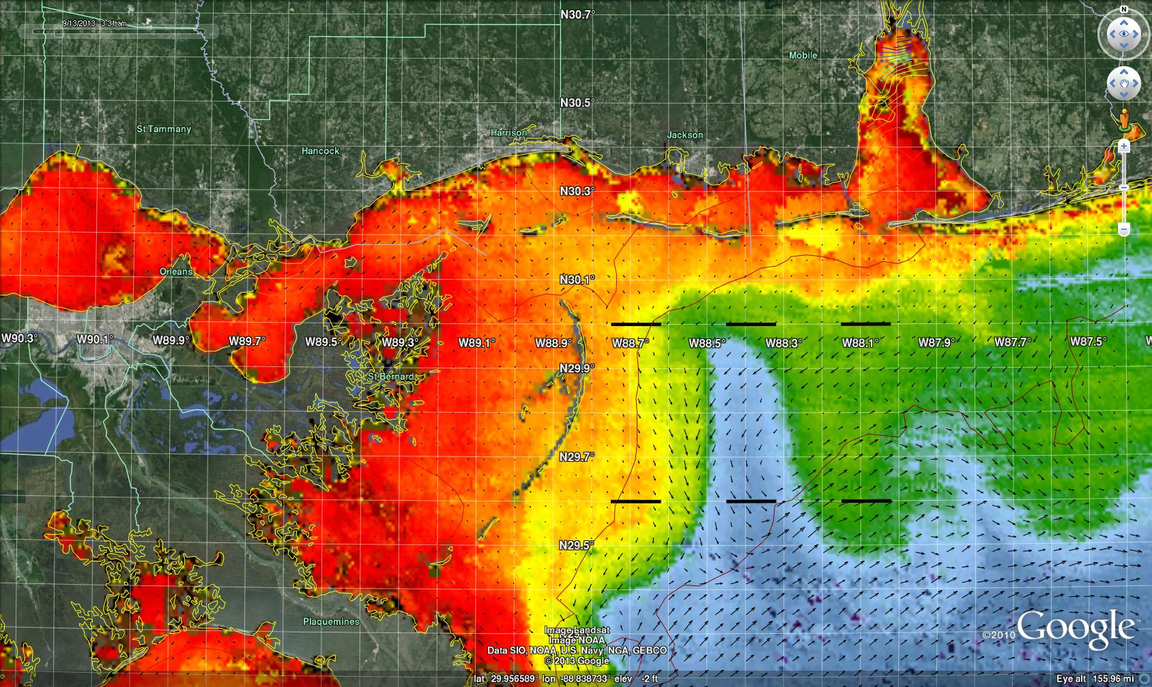
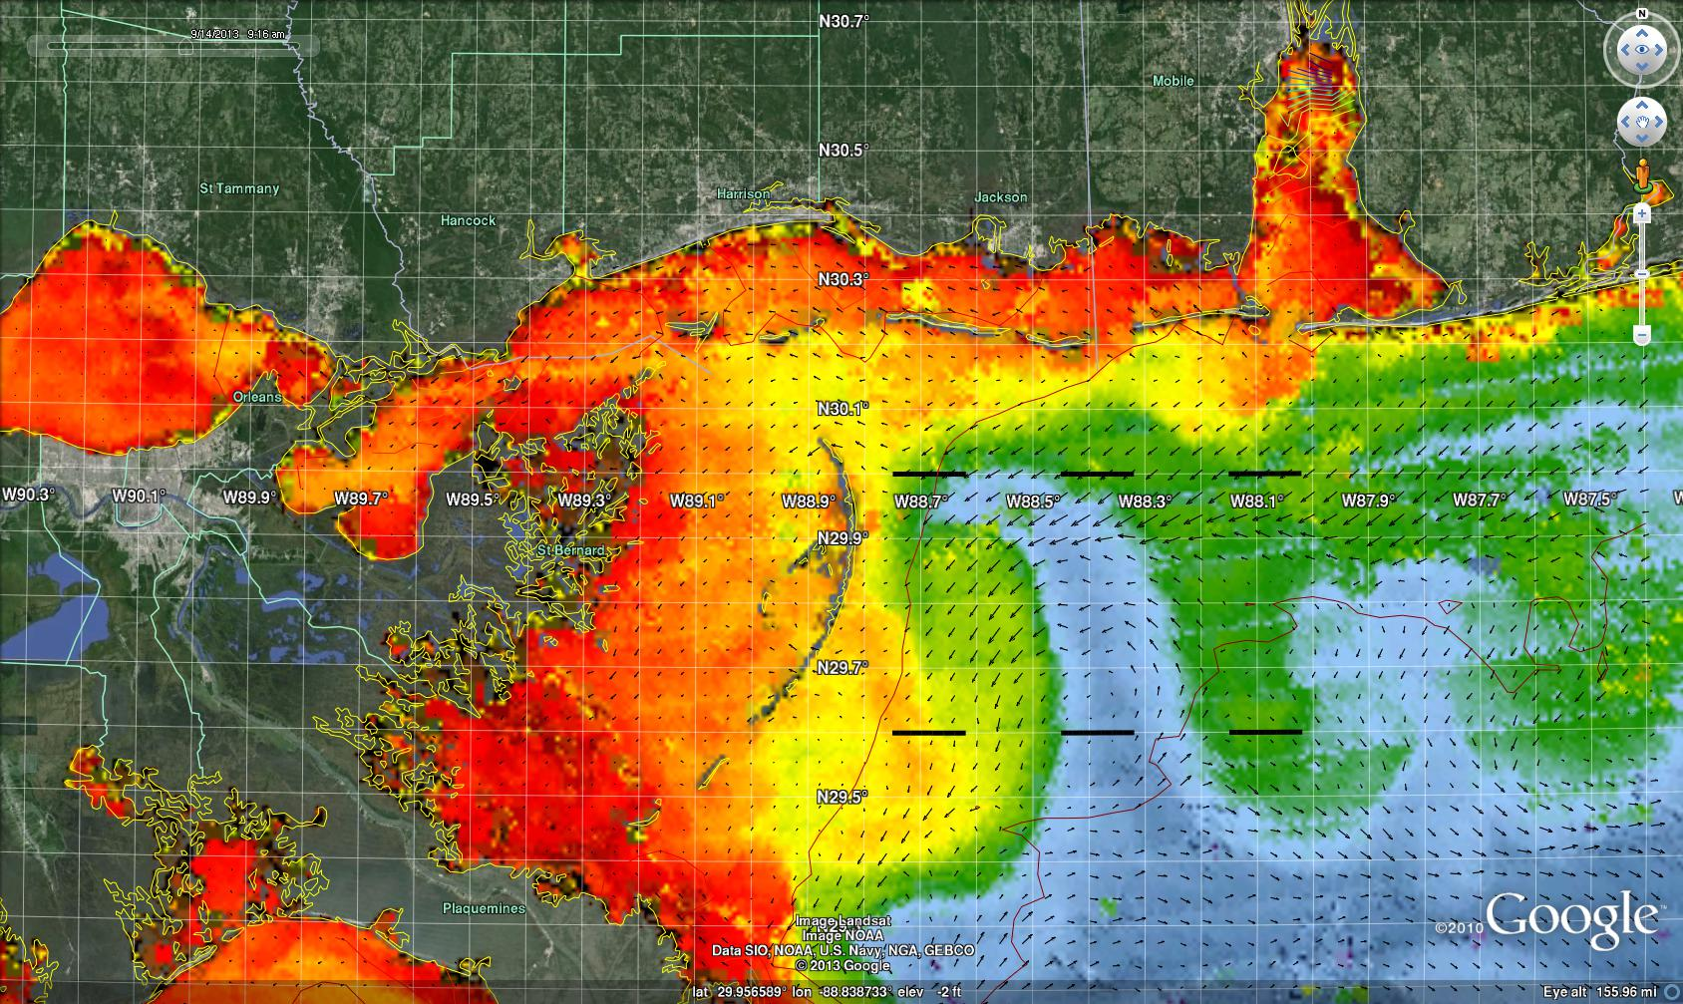
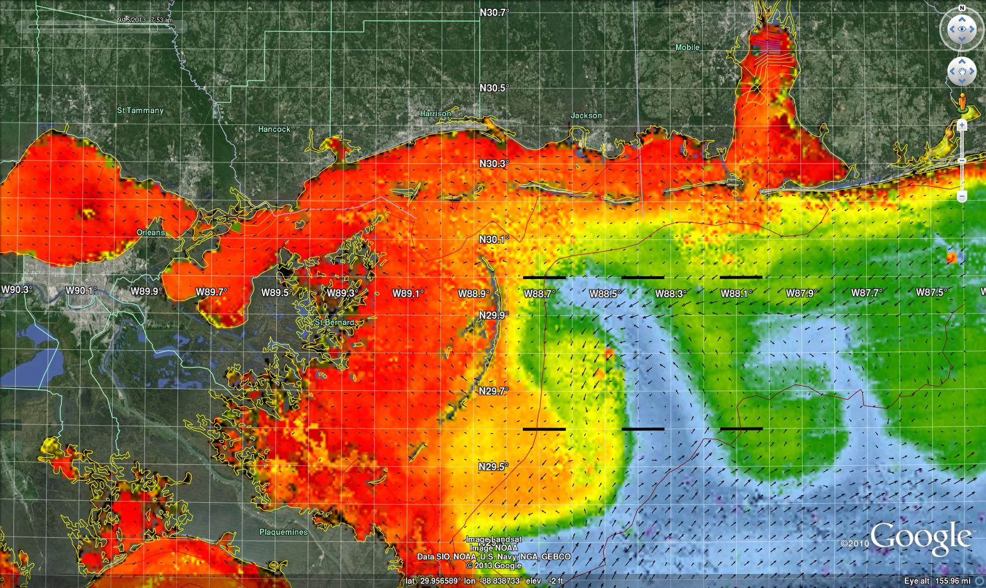
Interaction of Coastal Filaments and offshore waters
Ecological Exchange Processes and transport
Chlorophyll and HYCOM Currents
Sept 15, 2013
Chlorophyll and HYCOM Currents
Sept 14, 2013
Chlorophyll and HYCOM Currents
Sept 13, 2013
HYCOM – Sept 13
2 3
4 5 6
What is the
Transport
Sections 1- 6
2 3
4 5 6
Are there Preferred Corridors
Of exchanges Pathways?

Slide 2
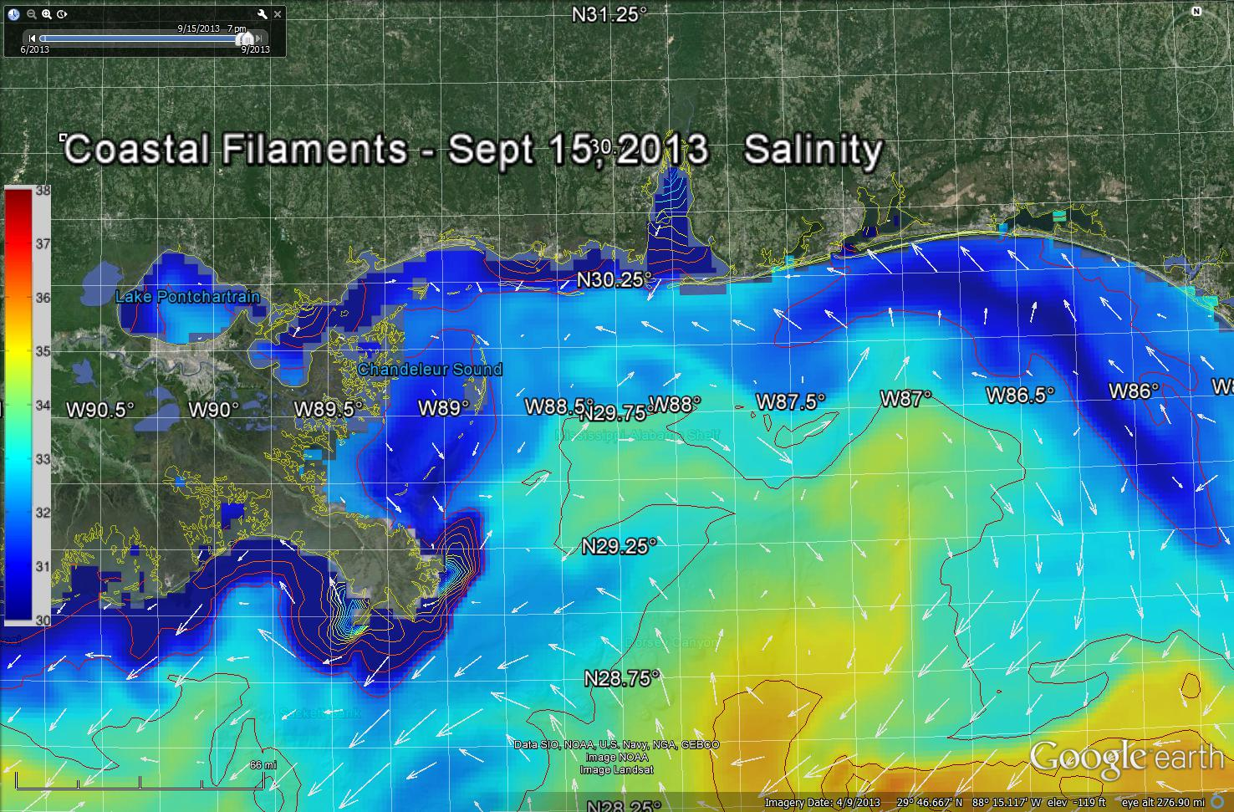
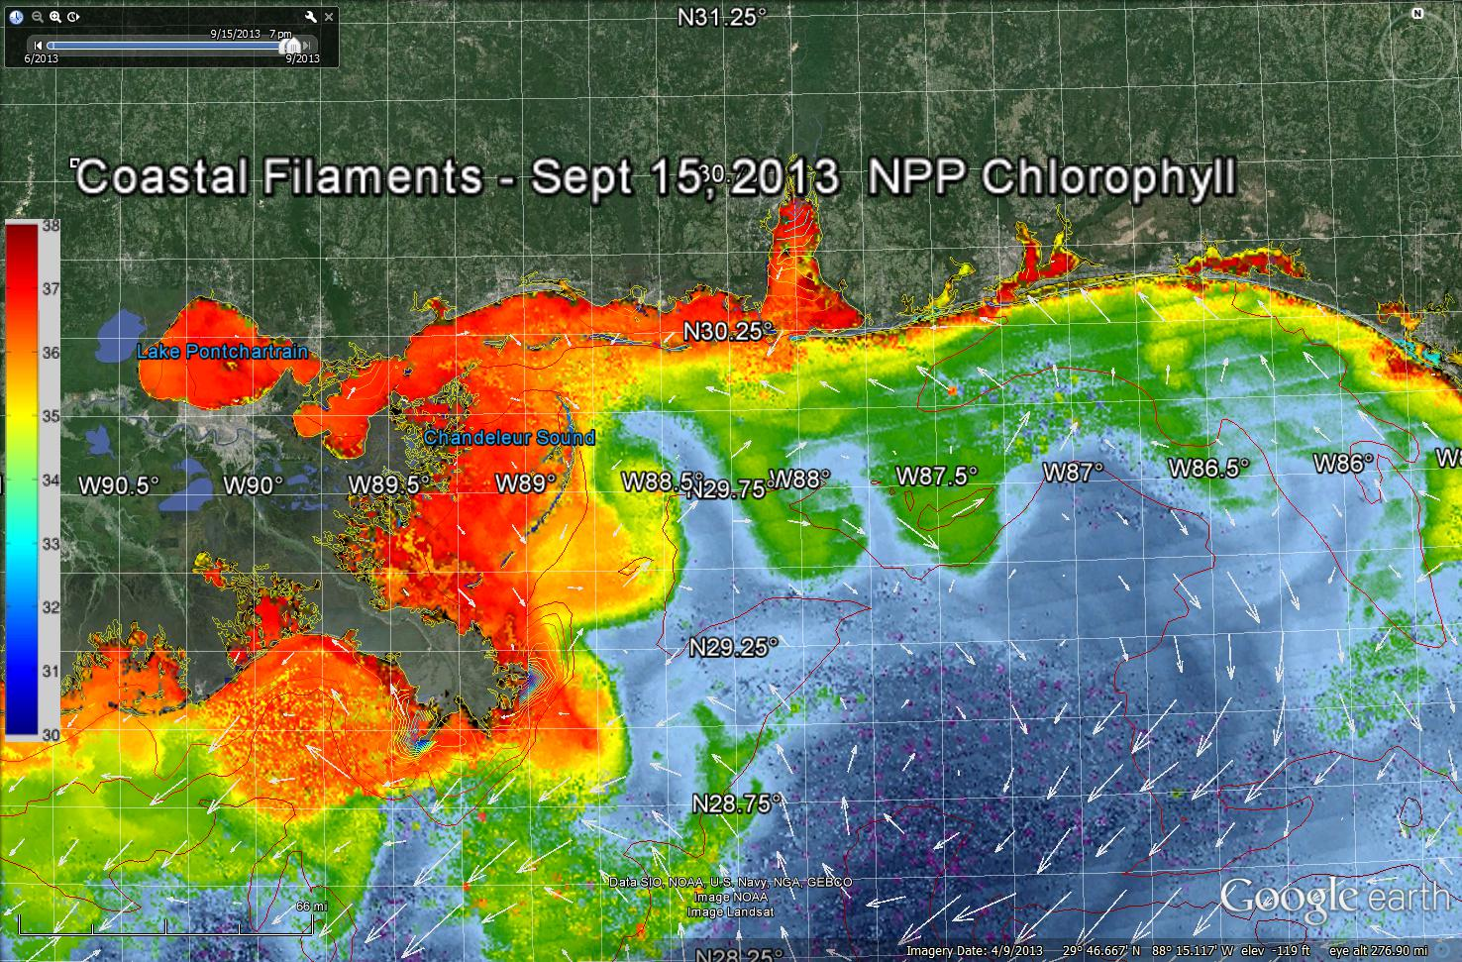
How do Ecological processes interact with Physical processes?
AM Seas – NCOM
NCOM Surface Salinity Contours
Surface Salinity
Intrusion of
Offshore waters
Anticyclonic Eddy
Next look at the Subsurface processes

Slide 3
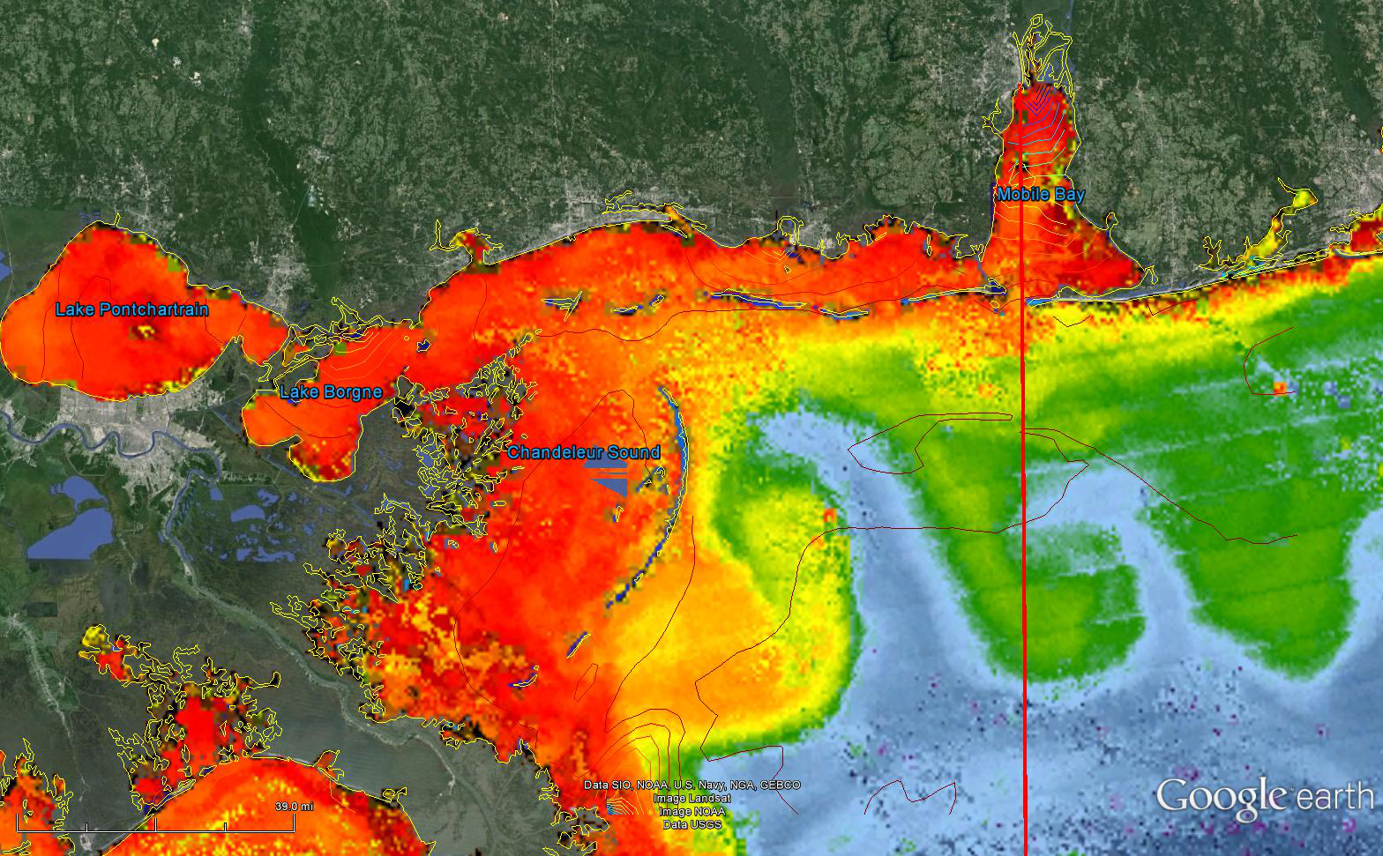
Sept 15 , 20113
Salinity

Slide 4
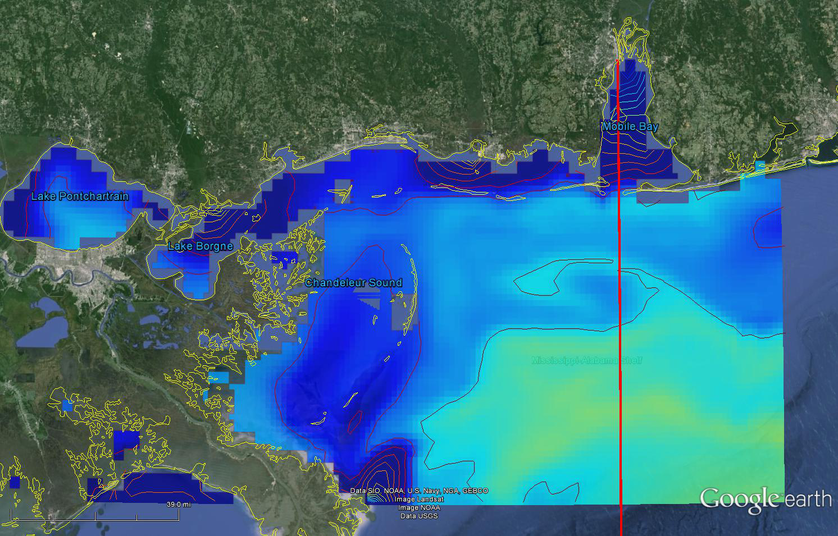
NCOM Modeled surface Salinity – Sept 15, 2013
Salinity

Slide 5
Mobile Cross Section Sept 15,2013 NCOM
Mobile
Interaction of bottom water
With the shelf
Estuary
Density
Temp
Salinity
Offshore
Transport to coast

Slide 6
Surface
Chlorophyll Sept 15
Salinity
NCOM
MOBILE
Cross
Section
How is the surface Biology Coupled
To the subsurface physics ?

Slide 7
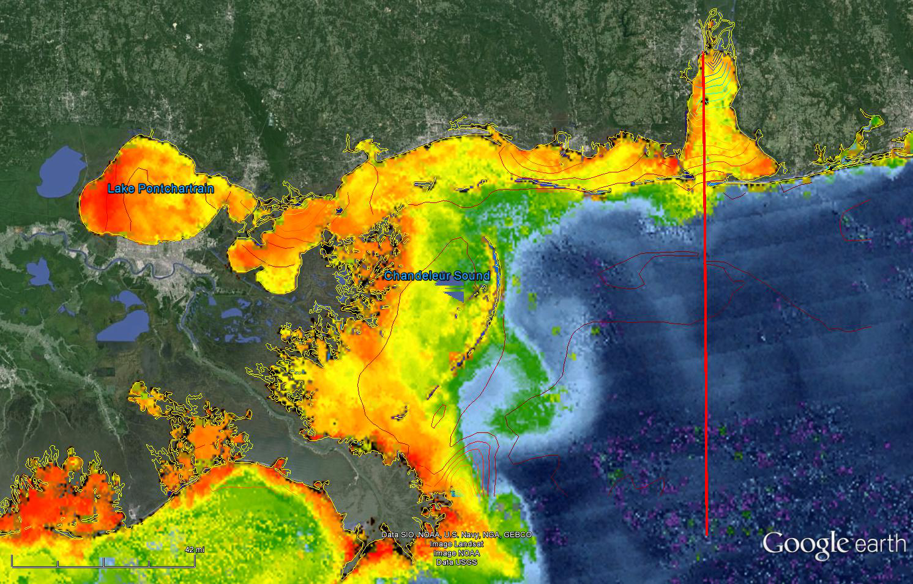
Surface
Particle Backscattering 551
Salinity
NCOM
Mobile
Cross
Section
How is the surface Biology Coupled
To the subsurface physics ?

Slide 8
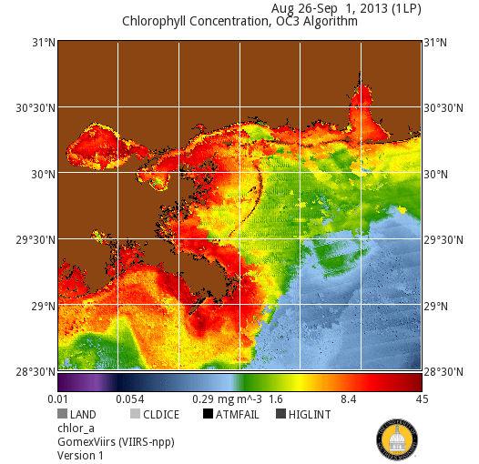
Animation of the Chlorophyll
Month of Sept 2013
Highly varying surface Biological Field in Sept.

Slide 9
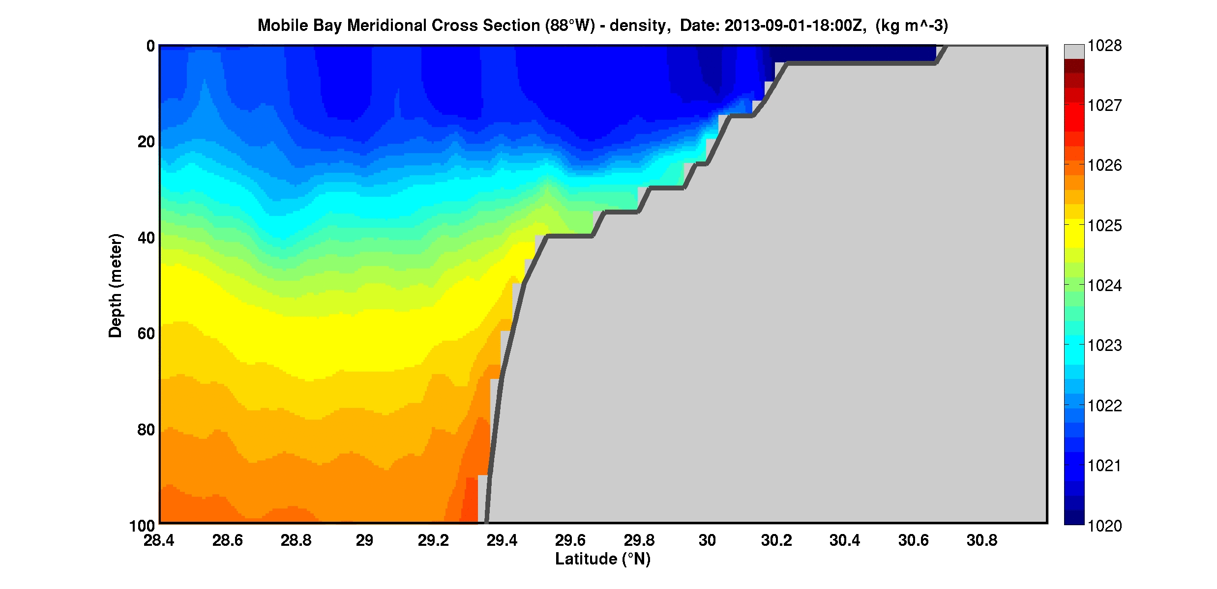
Monthly Animation – Mobile Cross Section
Sept 2013
- NCOM Density
Sept NCOM Mobile Density

Slide 10
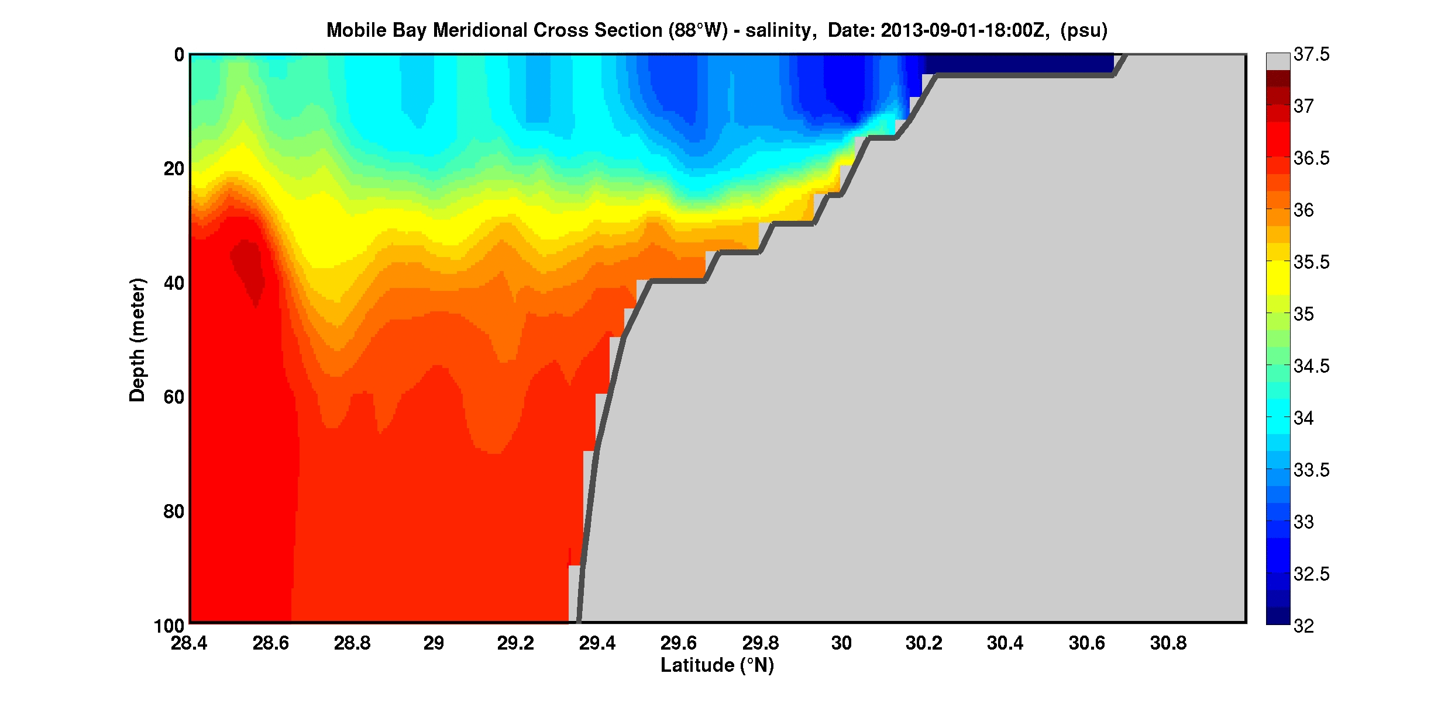
Monthly Animation – Mobile Cross Section
Sept 2013
- NCOM Salinity
Variations in the surface
Horizontal movements
Sept NCOM Mobile Salinity

Slide 11
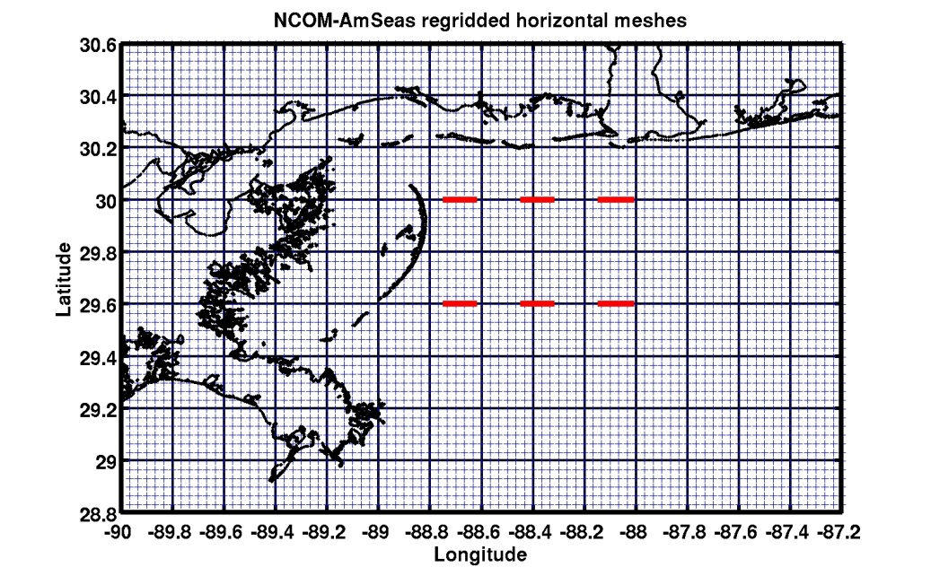
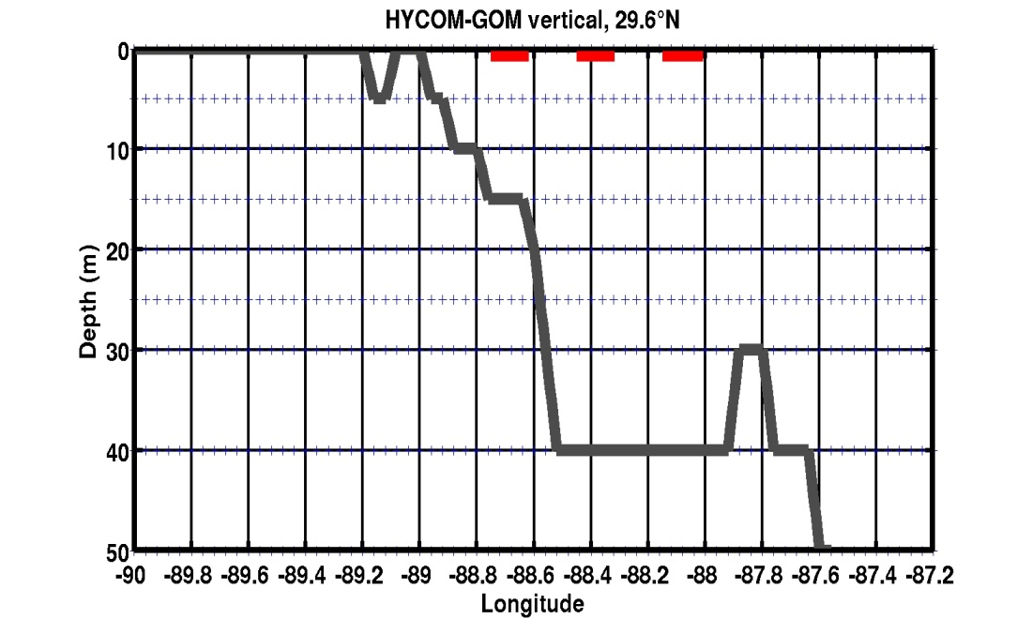
On Shore – Offshore Exchange
North South Volume Transport
Cross Sections
Vertical Layers
4 5 6
0
Chandeliers
Surface
Mid -
Bottom
1 2 3
Mobile
10
4 5 6
20
Depth (m)
Sea
Floor
30
40
“Corridors of Transport”
50
Distance
Integrate of upper 5 m of NCOM and HYCOM
Surface Flux
~4 horizontal grid Points (12.5 km)
HYCOM Vertical - 0,5,10,20,25,30,35,40 m
~4 horizontal grid Points (12.5 km)
NCOM Vertical - 0,2,4,6,8,10,12,15,20,25,30,35,40
~5 horizontal grid Points (12.5 km)

Slide 12
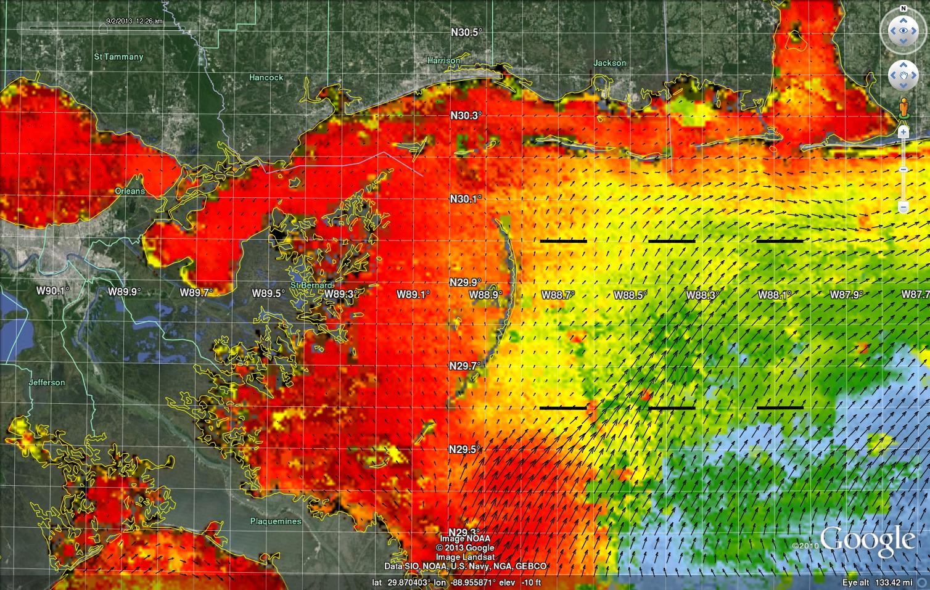
Transport
N
S
1 2 3
4 5 6
Sept 2, 2013
Shelf Response to Incoming Filament 10 Day History

Slide 13
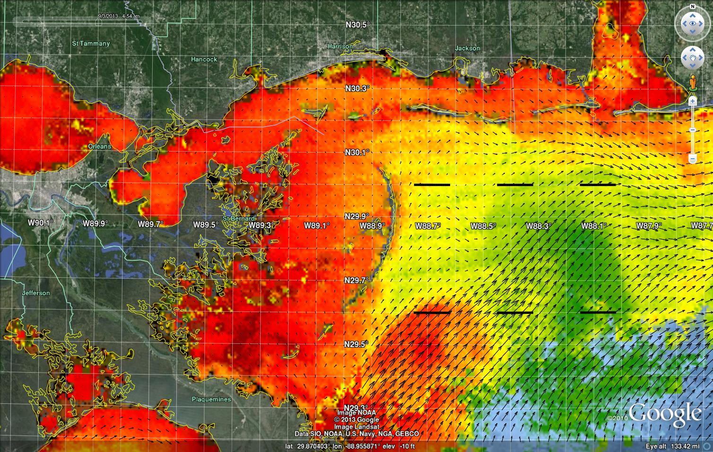
N
S
1 2 3
4 5 6
Sept 3, 2013

Slide 14
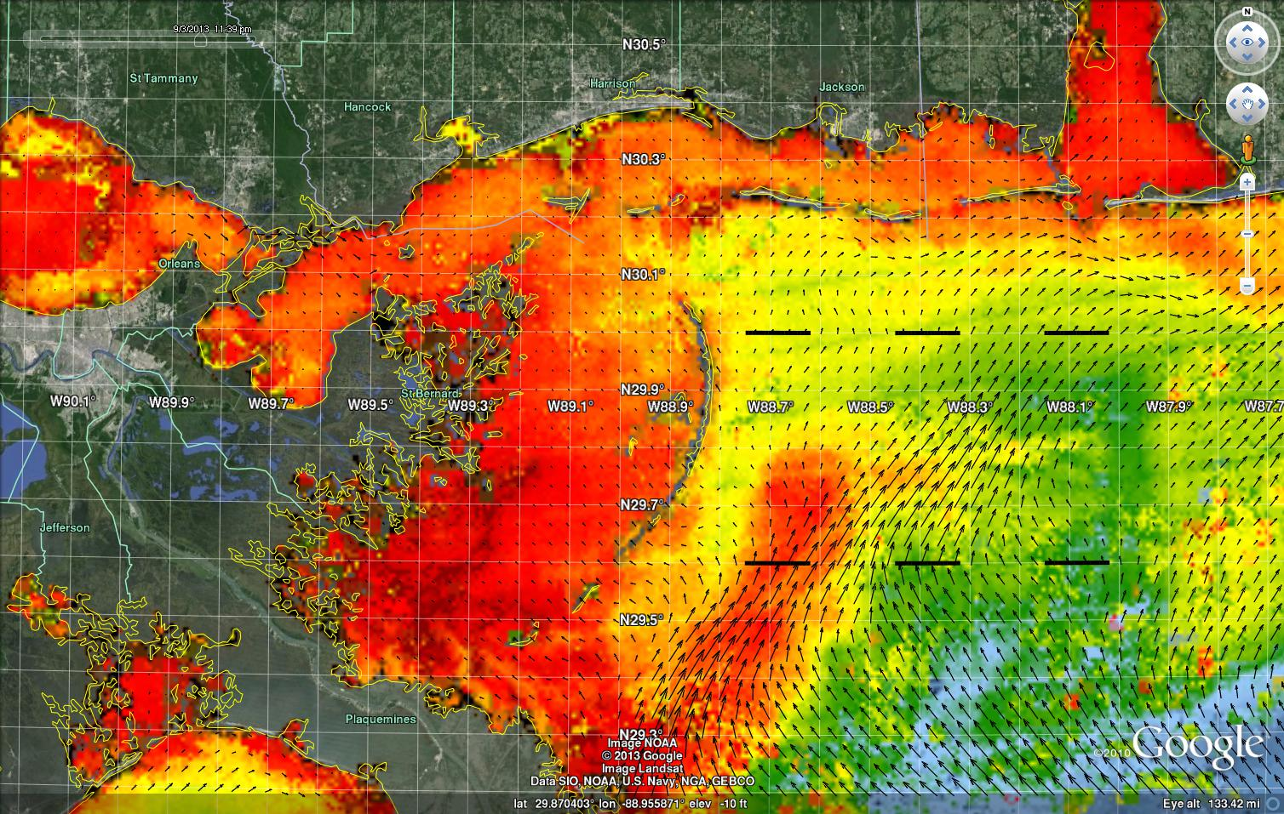
Transport
N
S
1 2 3
4 5 6
Sept 4, 2013

Slide 15
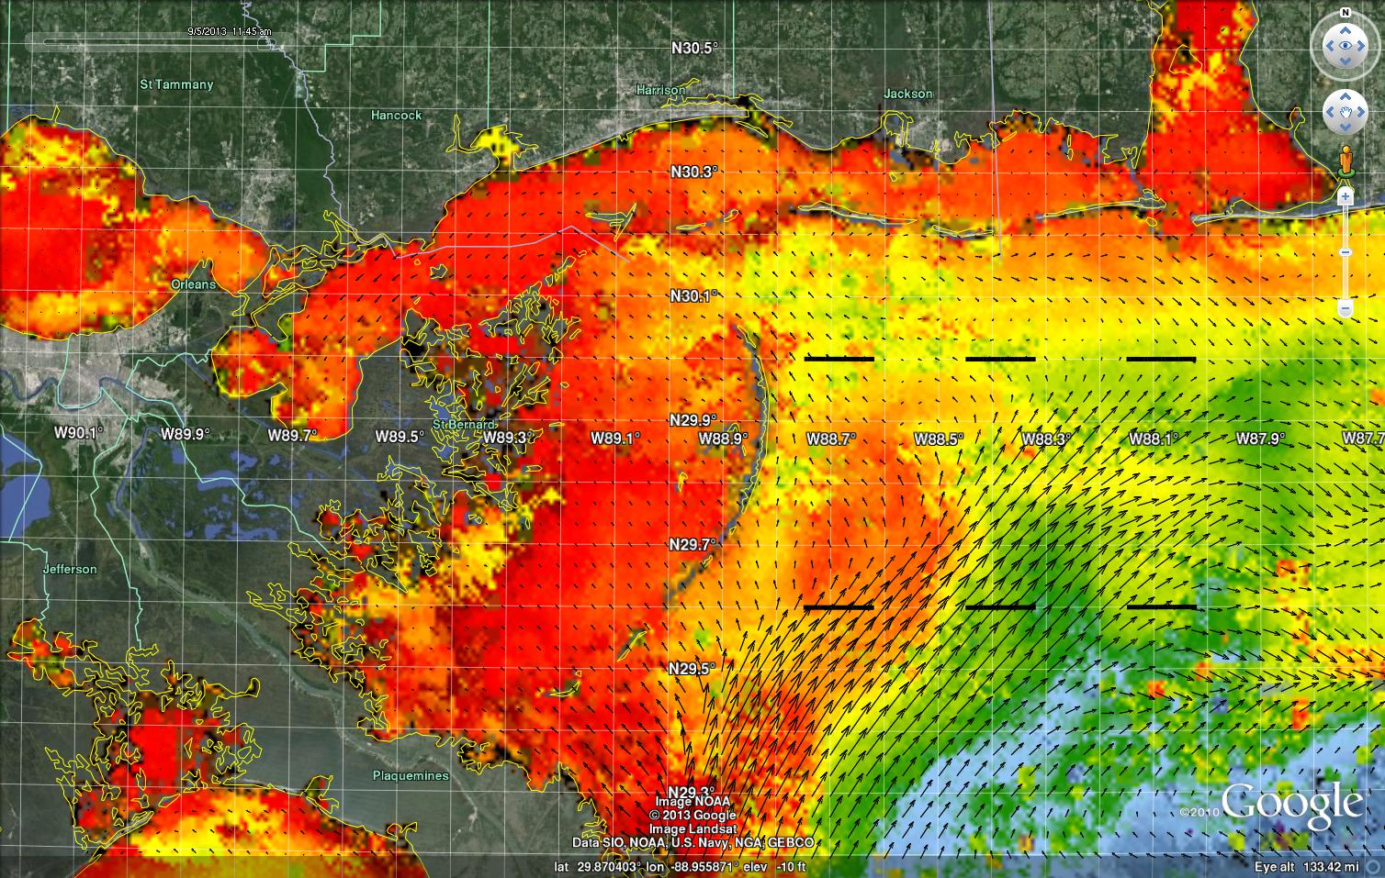
Transport
1 2 3
4 5 6
Sept 5, 2013

Slide 16
Variability in the offshore transport
8 Month -- Surface Transport
May – Dec 2013
11 day running Mean
1 2 3
4 5 6
Pulses of
Onshore
Offshore
Transport
North
Transport
N
S
South
Transport
Chlorophyll
May Jun Jul Aug Sept Oct Nov Dec

Slide 17
Interaction of Coastal Filaments and offshore waters
Ecological Exchange Processes and transport
“Shelf “ Total Flux
(6 sections Hycom)
May – Dec 2013
Surface –
-0.517 Sv(10⁶ m³ s⁻¹) Offshore
Mid-depth –
-0.125 Sv Offshore
Bottom Onshore
0.724 Sv
HYCOM – Sept 13
1 2 3
-0.488 -0.298 -0.125
4 5 6
-0.803 +0.370 +0.340
+0.008 +0.209 +0.106
-0.303 +0.503 +0.202
SURFACE
2 3
4 5 6
:
BOTTOM
Chl-Flux
NET CHLOROPHYLL FLUX from May to December 2013 (10^9 m3)
Section 1 : - 152 million liters or ~40 million gallons offshore flux Section 2 : - 64 million liters or ~17 million gallons offshore flux
Section 3 : - 22 million liters or ~6 million gallons offshore flux
Section 4 : - 215 million liters or ~57 million gallons offshore flux
Section 5 : + 105 million liters or ~28 million gallons onshore flux
Section 6 : + 68 million liters or ~18 million gallons onshore flux
-152 - 64 -22 x 10³ kg chl
SURFACE
BOTTOM
Local River Flux (SV)
Mississippi 0 .0181 10⁶ m³ s⁻¹
Mobile River 0.00220 10⁶ m³ s⁻¹
Total Biomass Flux (sfc)
- 280 x10³ kg chl
Chl-Flux
-215 +105 +68
Chl-Flux = Chl(mg/l) * Transport(10⁶m³s¹) * 86400sday⁻¹)/1000

Slide 18
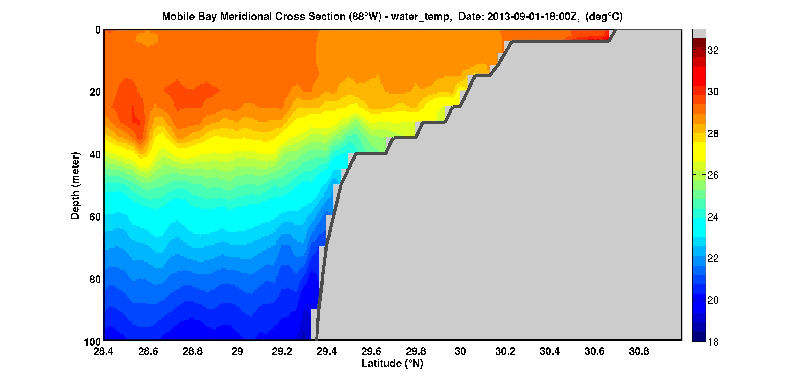
Monthly Animation – Mobile Cross Section
Sept 2013
- NCOM – Temperature
Sept NCOM Mobile Temperature

Slide 19
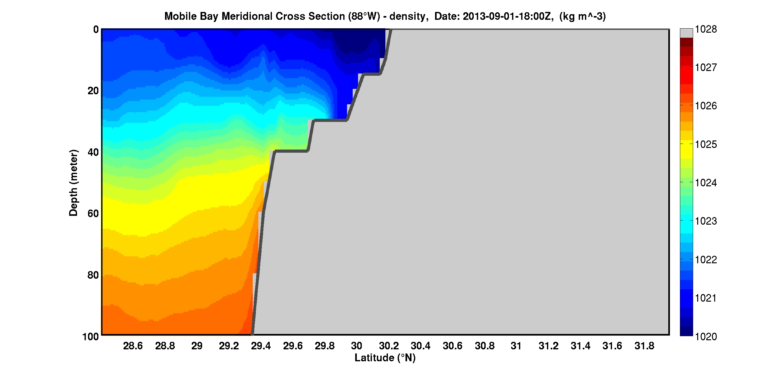
Monthly Animation – Mobile Cross Section
Sept 2013
- HYCOM Density

Slide 20
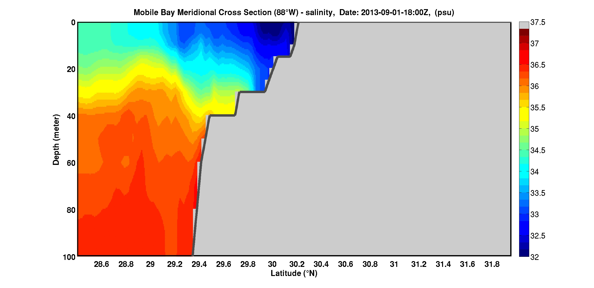
Monthly Animation – Mobile Cross Section
Sept 2013
- HYCOM Salinity

Slide 21
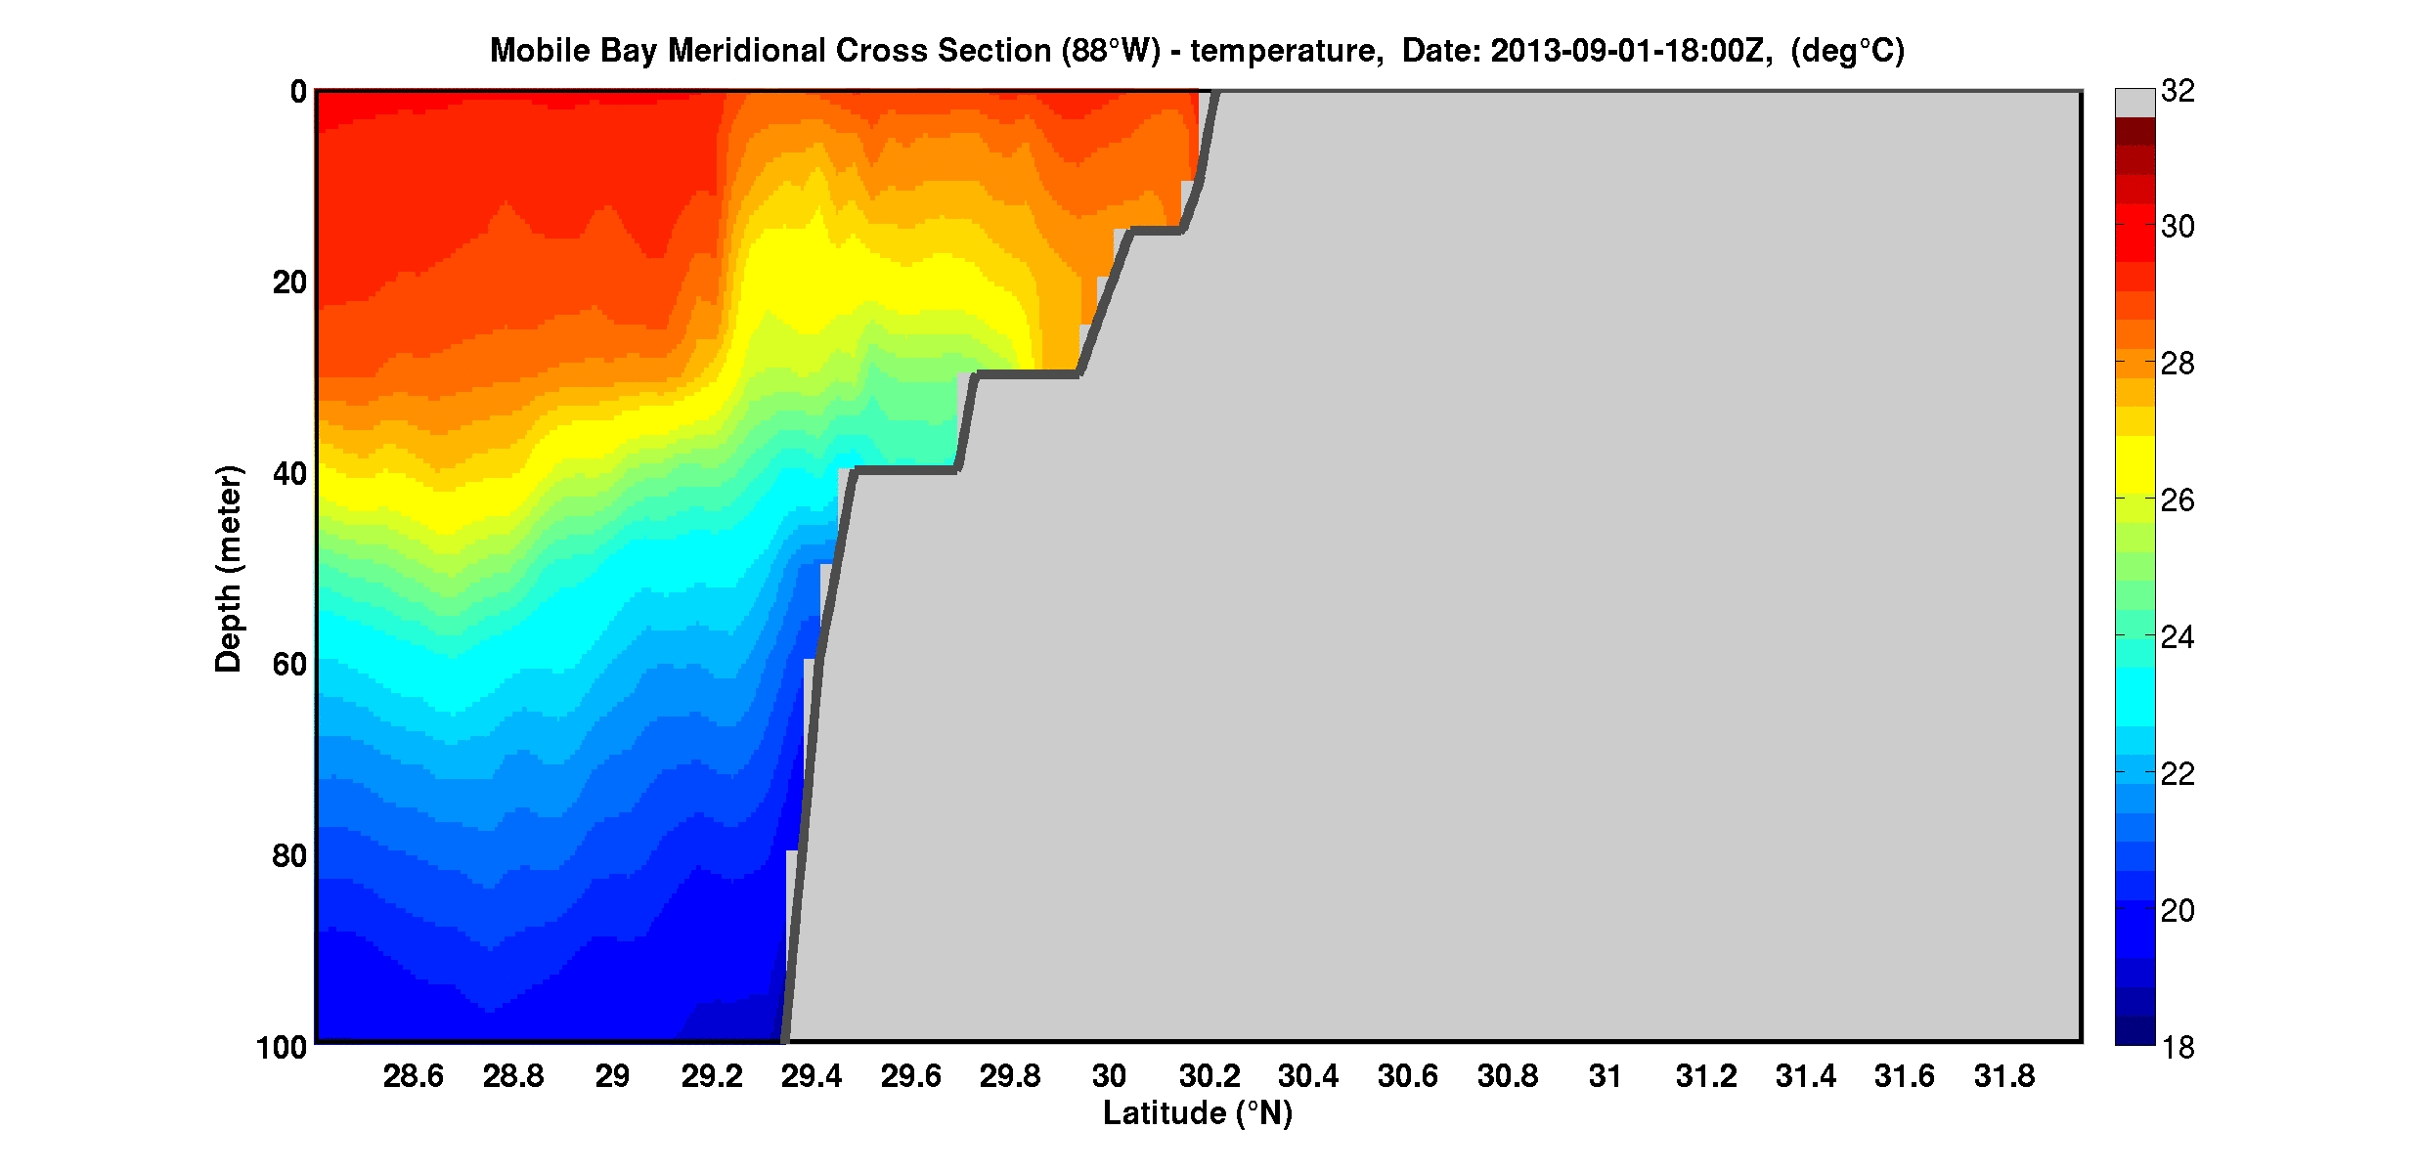
Monthly Animation – Mobile Cross Section
Sept 2013
- HYCOM Temperature

